Slide 1



Weekly Review
Gobind Sugar Mill, Aira
28th Dec. to 03th Jan. 2026

Slide 2
Production & Sales (Budget vs Actual)
Production (F.Y. 2025-26)
Particulars | Current Month (Jan,26) |  | Last Month (Dec,25) |  | YTD Till Last Month (Up to Dec,25)
 | Budgeted | Actual-till 3rd , Jan-26 | Budgeted | Actual | Budgeted | Actual
Sugar (LQ) | 2.77 | 0.24 | 2.73 | 2.89 | 5.59 | 5.51
Power (LU) | 276.05 | 26.78 | 281.23 | 286.80 | 759.33 | 747.19
Ethanol (LL) | 30.00 | 3.69 | 37.20 | 36.17 | 272.91 | 268.60
Sales (F.Y.2025-26)
Particulars | Current Month (Jan ,26) |  | Last Month (Dec,25) |  | YTD Till Last Month (Up to Dec,25)
 | Budgeted | Actual-till 3rd , Jan-26 | Budgeted | Actual | Budgeted | Actual
Sugar (LQ) | 2.25 | 0.06 | 0.94 | 0.97 | 10.63 | 10.45
Power (LU) | 163.94 | 15.81 | 165.81 | 167.09 | 382.83 | 382.20
Ethanol (LL) | 30.00 | 3.15 | 37.20 | 37.65 | 272.91 | 269.44
Notes:
Dec-25 Sugar Sale Free 91140 Qtls & Export 6090 Qtl Total=97230 Qtls
Jan-26 Sugar Sale Free-5373 qtl & Export 420 Qtl Total=5793 qtl

Slide 3

SPE Weekly Snapshot
Production Parameters | Current Week | Last Week | Till Date
Total Sugarcane Crush (LQ) | 6.91 | 7.51 | 63.14
Sugar Recovery | 10.44% | 10.43% | 9.89%
Cane for Syrup (LQ) | 1.21 | 1.17 | 11.64
Sugar Produced (LQ) | 0.61 | 0.65 | 5.75
Ethanol Produced (LL) | 8.32 | 8.42 | 77.53
Power Generation (LU) | 63.66 | 64.71 | 636.12
Power Export (LU) | 36.80 | 36.92 | 375.73
Cane Payment (Cr) | 25.07 | 20.99 | 218.78
Capacity Utilization | Current Week | Last Week | Till Date
Season Days | 7 | 7 | 70
Milling PUF | 98.79% | 107.29% | 100.08%
Sugar Bagging (Nos.) Actual/Capacity | 61040/59511 | 65297/66066 | 574812/580625
Power PUF | 94.73 | 96.30 | 94.66
Distillery PUF | 95.11% | 96.20% | 95.33%
Bagasse Pol % | 1.71% | 1.71% | 1.75%
Bagasse Moisture | 50.09% | 50.07% | 50.13%
3

Slide 4
SPE Weekly Snapshot – Total Losses
This Week | Last Week | Till Date
2.58 | 2.52 | 2.11
4
Notes:
Pol in Cane

Slide 5
Comparison with Nearby as on 03.01.26
5

Slide 6
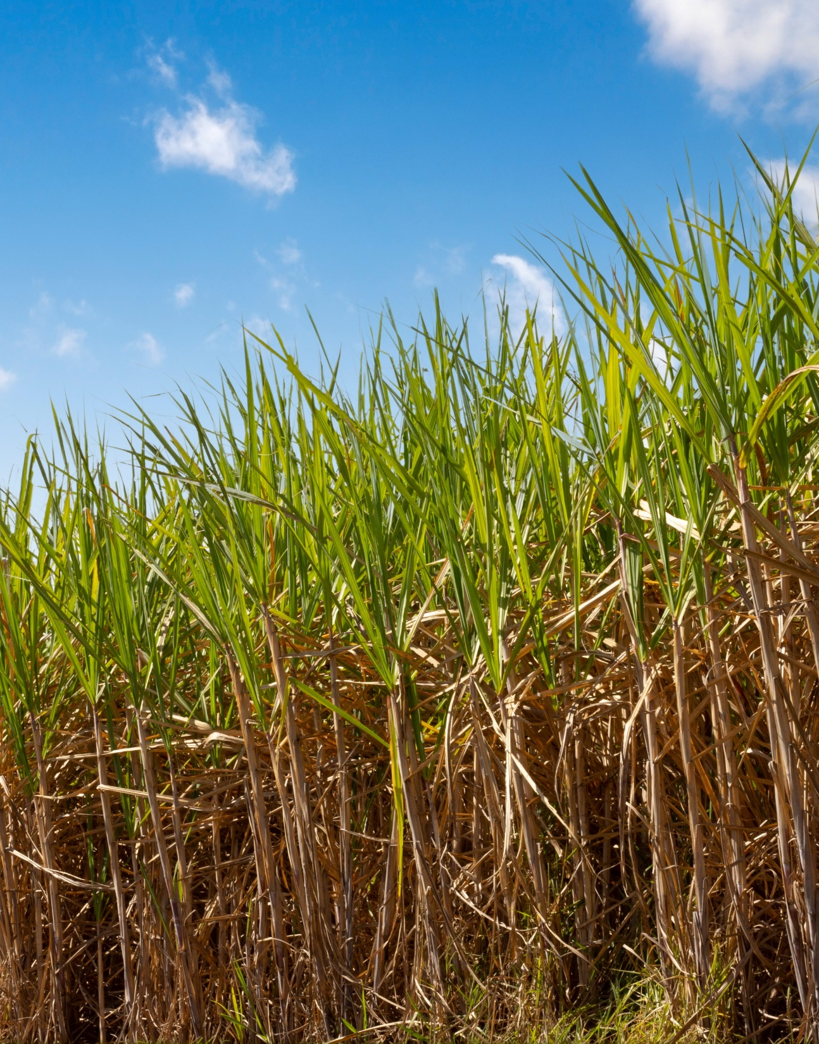
CANE

Slide 7
Action Taken Report
S. No | Discussion Point | Action Taken
1. | Single Source File Information Data from Society Level to Village Level with crop variety and soil types. | Work on integrating information and creating a single dashboard for Know you Farmer, Village and Society. Draft Dashboard Ready
2. | Transporter Performance Scorecard | Framework ready with indicators and evaluation matrix. Model to be developed.
3. | Cane loader Optimization Model | Work in Progress- Loader distribution data collected
4. | Purchi Failure | Phone calls made and information collected for 13326 purchies failed between 19thNov to 23rd Dec. total growers is 8466 not supply till date.
5. | Saksham App Discussion | Saksham App training for farmers being conducted thrice a week Usage cannot be tracked as no data analytics feature in Saksham to track usage. Just the registration details can be tracked.
5. | Road Safety – Cumulative Information | Accident Snapshot -23 incidents in 9 weeks Zero causality, but human/animal injuries reported 80% occurred on village roads & turns Repeating mechanical + road + electrical hazards

Slide 8
Weekly Performance Snapshot – Cane
S. No. | Capacity Utilization | Target | Current Week | Last Week | Till Date
1 | Daily Indent Rate Avg. (LQ) | As per requirement | 1.11 | 1.09 | 1.07
2 | Daily Cane Purchased Rate (LQ) | 1.00 | 0.99 | 1.07 | 1.00
3 | Gate Indent Maturity (%) | NA | 81% | 92% | 84%
4 | Center Indent Maturity (%) | NA | 71% | 99% | 91%
5 | Pol in Cane (%) | 13.80 | 13.02 | 13.01 | 12.05
6 | Middle Brix from Yard Sampling (%) | NA | 18.48 | 18.54 | 18.44
7 | Affected Cane % (from Yard Sampling) | NA | 0.5 | 1.1 | 1.60
8 | Avg. Center Cane Holding Time (Hrs.) | NA | 14.81 | 13.83 | 13.14

Slide 9
Indent, Yard Balance Vs Crushing (Lakh Qtls.) (03.01.26)

Slide 10
Cane Purchase trend till 03 Jan 2026

Slide 11
PoL Vs Recovery % (21.12.25 to 03.01.2026)

Slide 12
Historical Recovery Trend Vs Current (Last 6 years)

Slide 13
Indent Maturity (25.12.25 to 31.12.25)
Bottom 10 Centers |  |  |  |  |  |  | Top 10 Centers
S.No. | CENTRE NAME | SOCIETY NAME | INDENT (QTL) | MATURITY % | Remark |  | CENTRE NAME | SOCIETY NAME | INDENT (QTL) | MATURITY %
1 | GANJ | MAHMOODABAD | 1269 | 21.10% | More grower ratoon finish but Plant cane not harvested |  | JUNGLE MATERA | AIRA | 1764 | 118.79%
2 | AIRA KATHOUTIYA II | AIRA | 801 | 21.70% | Fortnight column increase due to less indent,grower having Ratoon Purchey not issued |  | KATHOUTIYA | NANPARA | 3681 | 118.66%
3 | BELTUA | AIRA | 3132 | 34.10% | More grower ratoon finish but Plant cane not harvested |  | GATE (MAHMOODABAD) | MAHMOODABAD | 3654 | 118.47%
4 | BEHNANPURWA | AIRA | 3906 | 43.50% |  |  | GATE(LMP) | LAKHIMPUR | 6822 | 118.23%
5 | RATANGANJ II | MAHMOODABAD | 1512 | 45.00% |  |  | JALLAPUR MAHSI | HARGAON | 2718 | 116.22%
6 | MURI | AIRA | 1143 | 51.20% |  |  | DARAPUR | HARGAON | 666 | 115.86%
7 | AANVA HARGAON | HARGAON | 531 | 53.40% |  |  | AANVA (ARNI) | ARNIKHANA | 738 | 115.81%
8 | BETI SAHDEO | AIRA | 6552 | 54.90% |  |  | MAHADEV /AMETHI - II | AIRA | 4482 | 115.66%
9 | KATAULI | AIRA | 5580 | 55.80% |  |  | KATKUSMA | LAKHIMPUR | 4194 | 115.30%
10 | URRA BAZAR | NANPARA | 5409 | 56.70% |  |  | NAKAHA | LAKHIMPUR | 7974 | 115.13%
Notes:
Good: >= 90% Average: >=70% and <90% Poor: <70%

Slide 14
Average Vehicle Holding time at Purchase Center (28.12.25 to 03.01.26)
Bottom 10 Centers |  |  |  |  |  |  |  | Top 10 Centers
S. No. | CENTRE NAME | SOCIETY | Time (Hrs) | Vehicles | Loading | Remark |  | CENTRE NAME | SOCIETY | Time (Hrs) | Vehicles | Loading
1 | KATAULI | AIRA | 10.48 | 100 | Loader | No cane lifting for one day due to Loader mechanical problems |  | MURI | AIRA | 0.33 | 19 | LABOUR
2 | GANJ | MAHMOODABAD | 8.77 | 19 | Labour | On the first day, a pre token was issued, but due to the truck not being fully loaded, the loading work was carried out the following day. |  | AANVA (ARNI) | ARNIKHANA | 1.21 | 28 | LABOUR
3 | SISAIYA - I | AIRA | 7.05 | 93 | Loader | Token issued same day but truck arrived next day due to mechanical problems |  | JUNGLE MATERA | AIRA | 1.27 | 67 | LOADER
4 | LAUKAHI | AIRA | 6.87 | 134 | Loader | The loader performs loading at this center during the second shift, but the pre-token is issued during the first shift. One loader works at 2 or 3 different centers. |  | PRATAPI BEHAR | AIRA | 1.37 | 72 | LOADER
5 | MAHADEV / AMETHI - II | AIRA | 6.84 | 108 | Loader |  |  | BELWA PURWA | BELRAYAN | 1.5 | 131 | LOADER
6 | GOORH - I | NANPARA | 6.31 | 173 | Loader |  |  | RAIPURBELTUA/ISHANAG | AIRA | 1.50 | 82 | LOADER
7 | SIKATIHA CHAPKAHA | AIRA | 6.21 | 135 | Loader |  |  | HARDI | AIRA | 1.54 | 48 | LOADER
8 | KALUWAPUR | AIRA | 6.06 | 166 | Loader |  |  | NAINAPUR II | AIRA | 1.55 | 90 | LOADER
9 | TELIYAR | BELRAYAN | 5.35 | 67 | Loader |  |  | AMETHI IV | AIRA | 1.58 | 106 | LABOUR
10 | BASANTAPUR/DHAURAHRA | AIRA | 5.33 | 238 | Loader | Grower's family incidence occurred, pre-token issued on first day but cane weighment done on 3rd day |  | BELTUA | AIRA | 1.64 | 33 | LOADER

Slide 15
Average Truck Holding Time at Purchase Centers (28.12.25 to 03.01.26)
Bottom 10 Centers |  |  |  |  |  |  |  | Top 10 Centers
S. NO. | CENTRE | SOCIETY | HOLDING TIME (HR) | TRIPS | LOADING | Remark |  | CENTRE | SOCIETY | HOLDING TIME (HR) | TRIPS | LOADING
1 | KHAJUHABAZAR III | AIRA | 7.01 | 12 | Loader | The weighment clerk at the center recorded a weight for the trolley/bullock cart that was greater than the weight of the truck it was loaded onto. The same truck number was then recorded on the remaining trolley/bullock cart's gross weight slip, which was weighed the following day. This caused the truck with that same number to arrive late the next day. |  | TAPARPURWA | BELRAYAN | 1.53 | 20 | Loader
2 | JALLAPUR MAHSI | HARGAON | 6.60 | 11 | Loader |  |  | PACHGHARA | AIRA | 1.57 | 14 | Loader
3 | RATANGANJ III | MAHMOODABAD | 6.23 | 7 | Labour |  |  | MANGAUDHIYA-III RAJ | NANPARA | 1.62 | 10 | Loader
4 | BELWA PASURA | HARGAON | 6.15 | 8 | Loader |  |  | DANDOORI | BELRAYAN | 1.65 | 13 | Loader
5 | CHAKLAKHIPUR- I | AIRA | 5.92 | 30 | Loader |  |  | KALUWAPUR | AIRA | 1.66 | 18 | Loader
6 | KATKUSMA | LAKHIMPUR | 5.61 | 17 | Loader |  |  | AMETHI IV | AIRA | 1.70 | 16 | Loader
7 | MURI | AIRA | 5.54 | 7 | Labour |  |  | DHAURAHARA II | AIRA | 1.71 | 9 | Loader
8 | SAKETHU | LAKHIMPUR | 5.54 | 33 | Loader |  |  | KIRATIPURVA - III | AIRA | 1.79 | 13 | Loader
9 | SISAIYA -I | AIRA | 5.52 | 11 | Loader |  |  | NAINAPUR-III | AIRA | 1.85 | 13 | Loader
10 | BASANTAPUR/DHAURAHRA | AIRA | 5.43 | 32 | Loader |  |  | KATAULI | AIRA | 1.86 | 11 | Loader

Slide 16
Zone wise Target V/S Cane supply 2025-26 up 03.01.2026

Slide 17
Society Wise Indent And Supply (28.12.2025 to 03.01.26)

Slide 18
Reason for failure of indent from 20.12.2025 to 26.12.2025

Slide 19
Society & village wise higher indent failure details 20.12.25 to 26.12.25

Slide 20
Reasons for indent failure details 17.12.25 to 23.12.25

Slide 21
Comparative Pol in Cane of Neighboring Sugar Factories (03.01.26)

Slide 22
Society wise new member register 2025-26
S.N. | Society Name | New member
1 | AIRA | 1942
2 | NANPARA | 342
3 | LAKHIMPUR | 206
4 | HARGAON | 190
5 | ARNIKHANA | 138
6 | BELRAYAN | 120
7 | MAHMOODABAD | 3
 | Grand Total | 2941

Slide 23
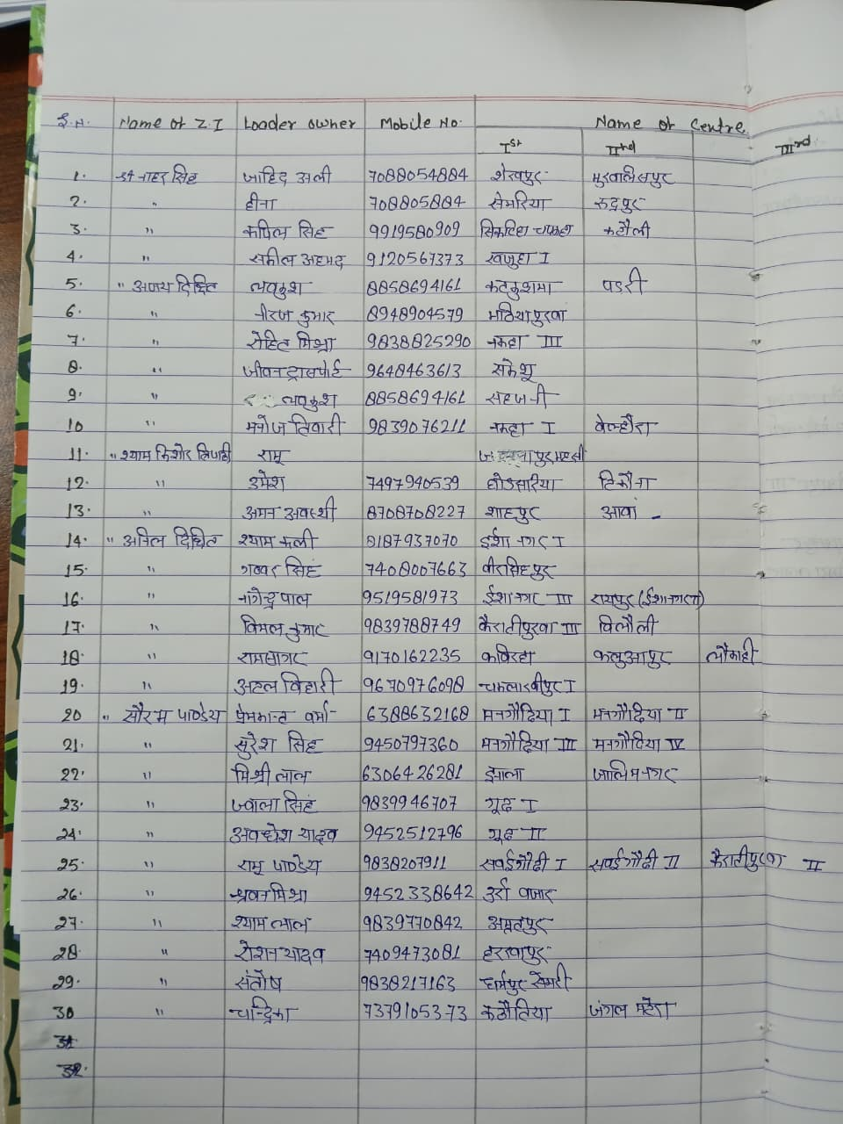
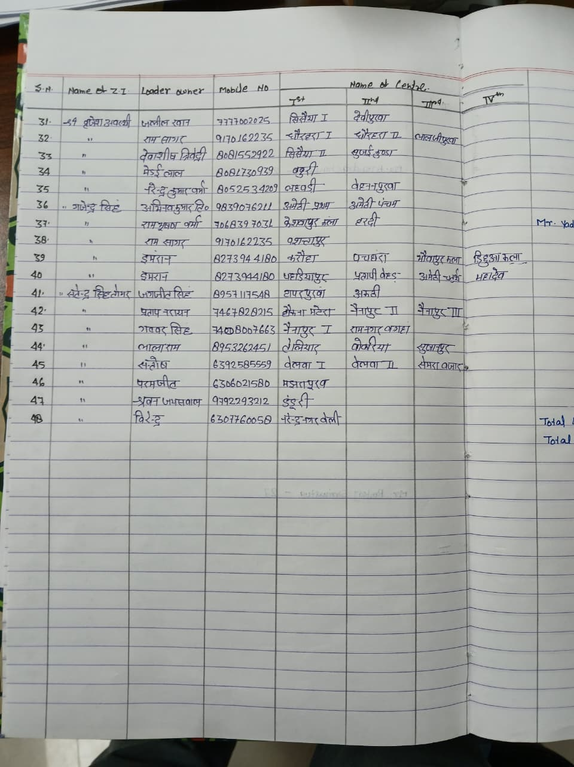
CANE LOADER LOADING SHIFT WISE DETAILS

Slide 24
CANE LOADER PERFORMANCE (28.12.25 to 03.01.26)
Category of Issue | No. of Cases | % of Total | Remarks
Spindle Broken | 3 | 25% | Major impact at Semra Bazar & Belwa 1st (21.5 hrs).
Clutch Plate Broken | 2 | 17% | Caused the highest single delay at Baburi (28.5 hrs).
Pressure Pipe Burst | 2 | 17% | Shorter delays at Goorh 2nd and Sakethu (~5 hrs).
Bush Broken | 1 | 8% | Resulted in a 24-hour halt across three centers.
Angle Broken | 1 | 8% | Significant 21-hour stoppage at Chaklakhipur 1st.
Jack/Pump/Other | 3 | 25% | Various hydraulic and structural snags.
Total | 12 | 100%
High downtime centers
Center | Downtime
Baburi | 28 hrs 30 min
Sujanpur | 24 hrs
Teliyar | 24 hrs
Bokariya | 24 hrs
Semra Bazar | 21 hrs 30 min

Slide 25
CANE LOADER PARTS RECEIVED IN CANE OFFICE

Slide 26
Yield Assessment(Ratoon) – 01 Nov 25 to 03 Jan 26
Overall Average Yield: 551 q/ha
Total Plots Assessed: 1716
Yield dispersion is significant, ranging from ~358 q/ha to ~793 q/ha
Variety | No. of plot | Average of Yield (QTL /Hec)
Colk-14202 | 1 | 793
co-98016 | 1 | 777
co-98015 | 1 | 738
Colk-16202 | 1 | 651
Colk-14201 | 200 | 591
co-0238 | 224 | 580
Co-0118 | 733 | 564
Cos-13235 | 59 | 555
Co-15023 | 78 | 537
Cos-13231 | 38 | 523
Cos-17231 | 2 | 520
Cos-95255 | 1 | 500
co-98014 | 107 | 496
Colk-94184 | 249 | 490
Cos-8272 | 9 | 451
Colk-12207 | 1 | 450
Coj-85 | 7 | 449
Cos-18231 | 3 | 398
UP 5125 | 1 | 358
Grand Total | 1716 | 551
S.N. | Society Name | No. of plot | Avg. Yield (QTL /Hec)
1 | BELRAYAN | 25 | 633
2 | AIRA | 1199 | 575
3 | MAHMOODABAD | 50 | 569
4 | HARGAON | 109 | 538
5 | NANPARA | 114 | 537
6 | ARNIKHANA | 76 | 460
7 | LAKHIMPUR | 143 | 397
 | Grand Total | 1716 | 551

Slide 27
Soil Sample Collection by Saksham App

Slide 28
ROAD SAFETY (28.12.25 to 03.01.26)

Slide 29
Call Center Update (28.12.25 to 03.01.26)
Banners at all 106 centres displayed
Category | No. of Cases | % of Total | Remarks
Others | 4 | 44% | Covers cane calendar inquiries, app usage guidance, and purchey revalidation.
Payment related Query | 2 | 22% | Involved investigating payment lapses with concerned authorities.
Truck not available at center | 2 | 22% | Required escalation to Zonal managers to arrange for transport.
Purchey expired | 1 | 11% | Referred to authorities for revalidation of grower codes.
Total | 9 | 100% | All cases are currently marked as Resolved.

Slide 30
Progress report of Saksham App installation as per Zonal Incharge till 03.01.2026
Date | Saksham App enrollment status
 | On date | To date
28/12/2025 | 69 | 39502
29/12/2025 | 58 | 39560
30/12/2025 | 83 | 39643
31/12/2025 | 67 | 39710
01/01/2026 | 40 | 39750
02/01/2026 | 47 | 39797
03/01/2026 | 58 | 39855

Slide 31
Comparative Payment Figures of Neighboring Mills (As on 03.01.2026)
Name of Factory | Date of Start | Payment Up to
Aira | 26.10.2025 | 20.12.2025
Ajbapur | 27.10.2025 | 26.12.2025
Kumbhi | 31.10.2025 | 30.12.2025
Gularia | 31.10.2025 | 30.12.2025
Belrayan | 12.11.2025 | 12.12.2025
Gola | 05.11.2025 | 11.02.2025
Pallia | 07.11.2025 | 16.02.2025
Khambharkhera | 05.11.2025 | 22.02.2025

Slide 32
KOLHU AND CRUSHERS cane crush in our allocated area
Particulars | Total (No’s) | Rate/ Qtl. (Rs.) | Running (No’s) |  | Crushing (Qtls.) |  | Recovery (%)
 |  |  | This week | To Date (03.01.26) | This week | To Date (03.01.26)
Kolhu | 192 | 380-440 | 0 | 140 | 78400 | 1198910 | 12.40%
Crushers | 15 | 370-390 | 0 | 13 | 436000 | 1467500 | NA
 | Total: |  |  |  | 514400 | 2666410

Slide 33
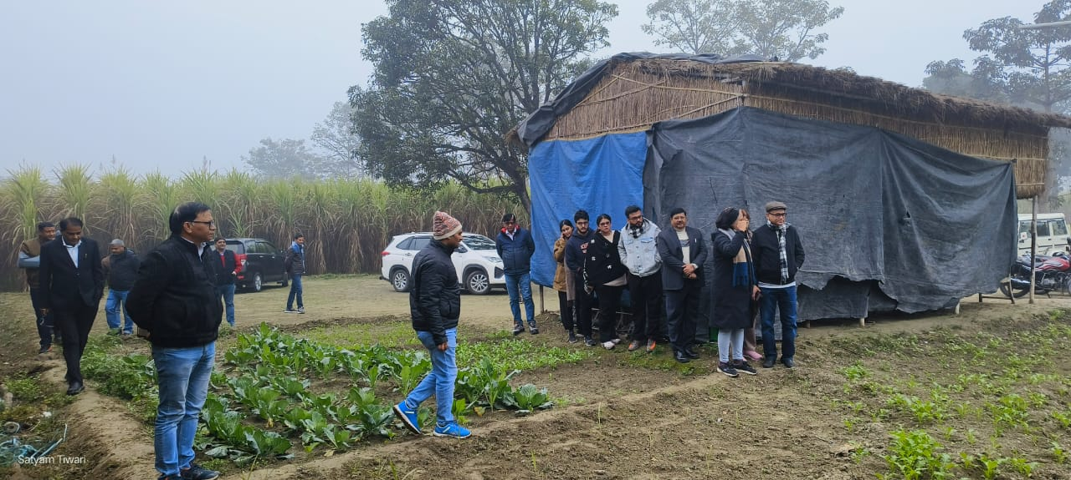
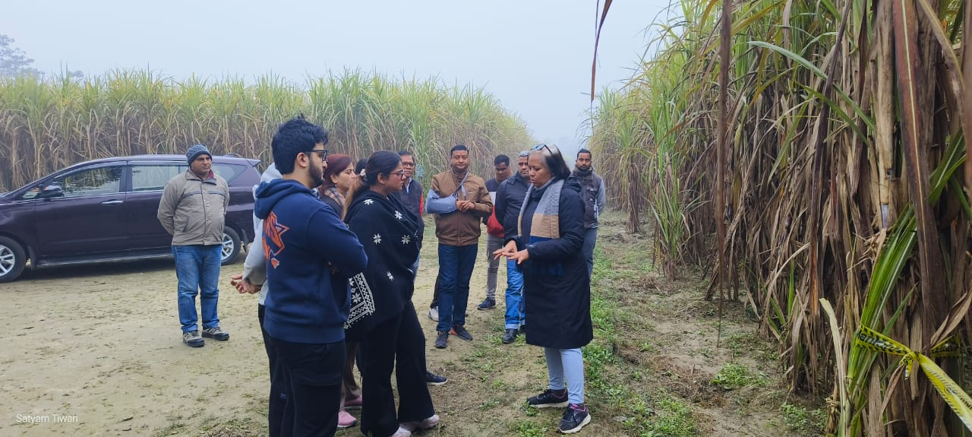
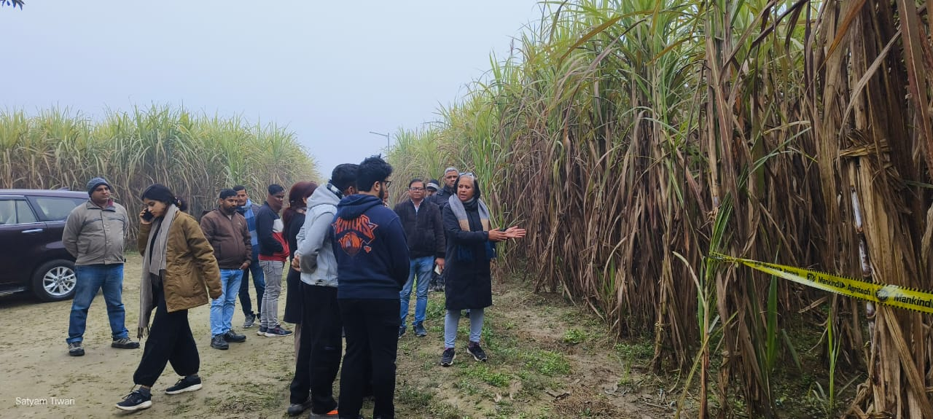
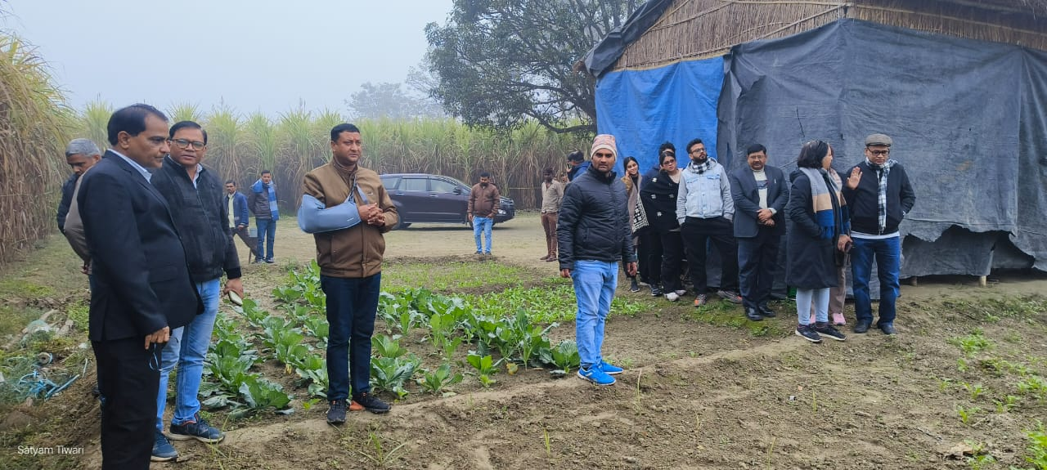
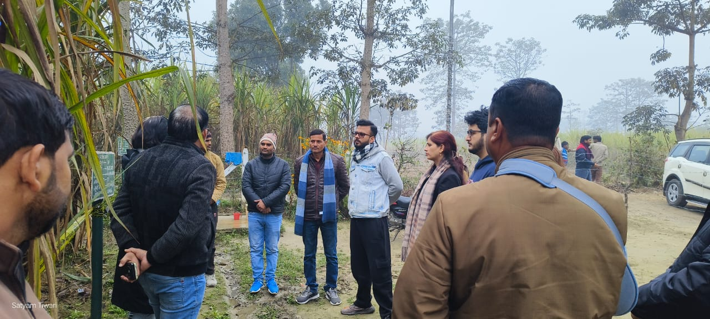
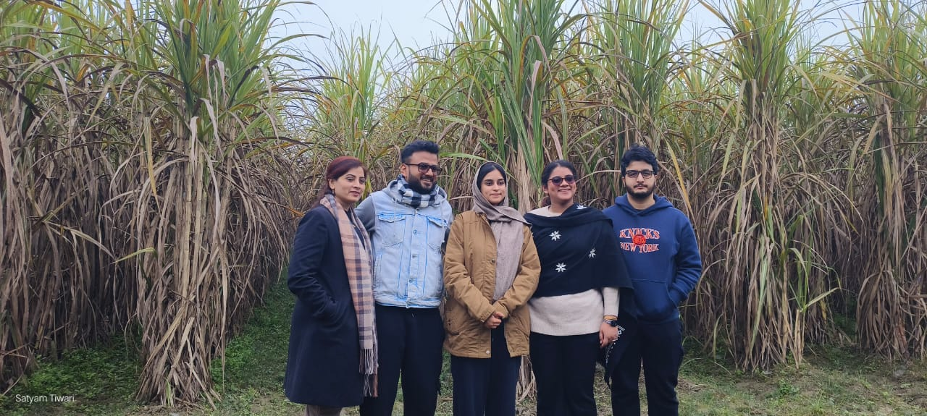
R&D farm was visited by the Resp. M.D. Sir along with his family.

Slide 34
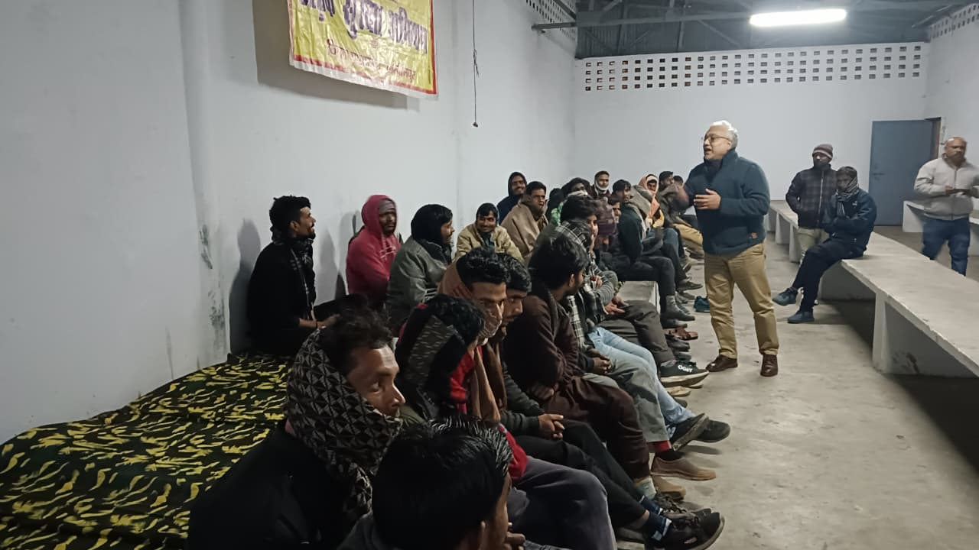
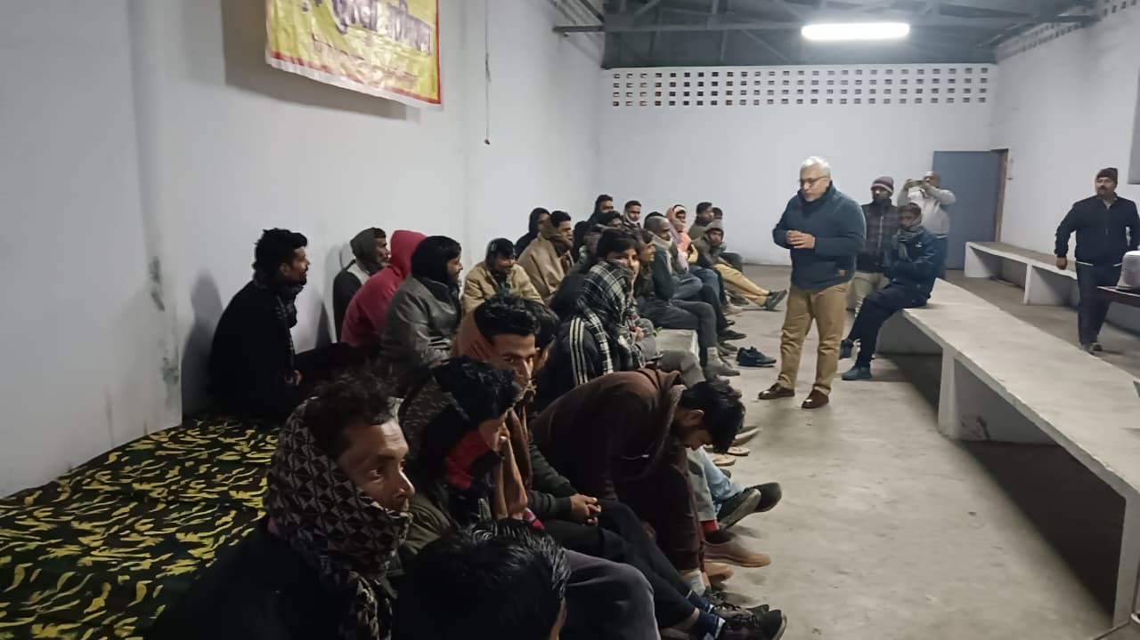
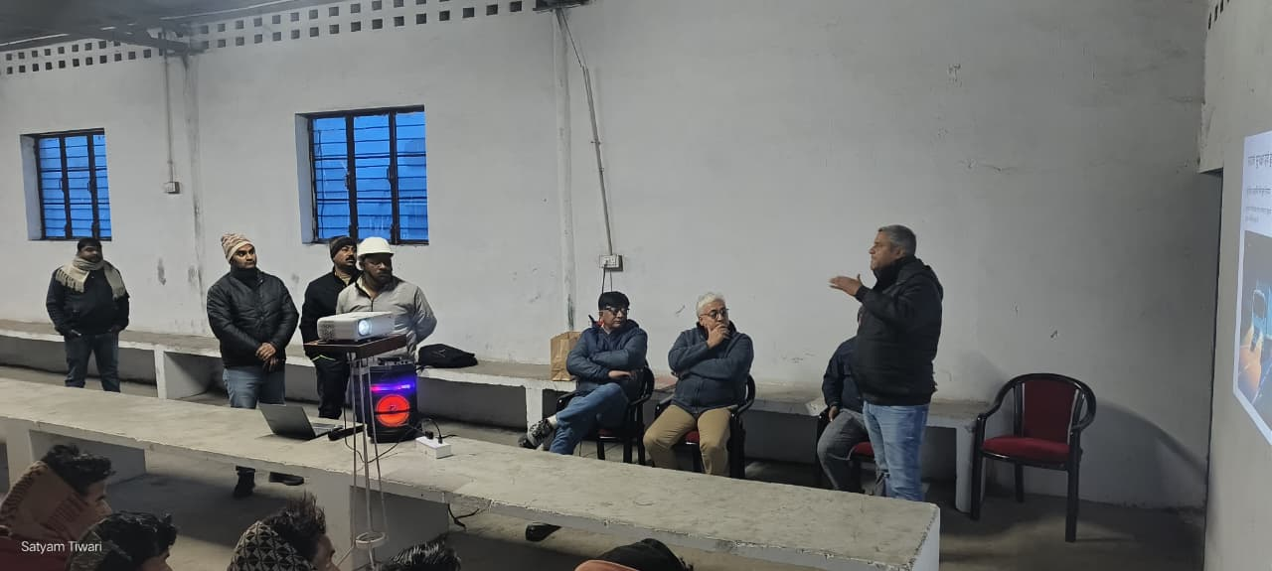
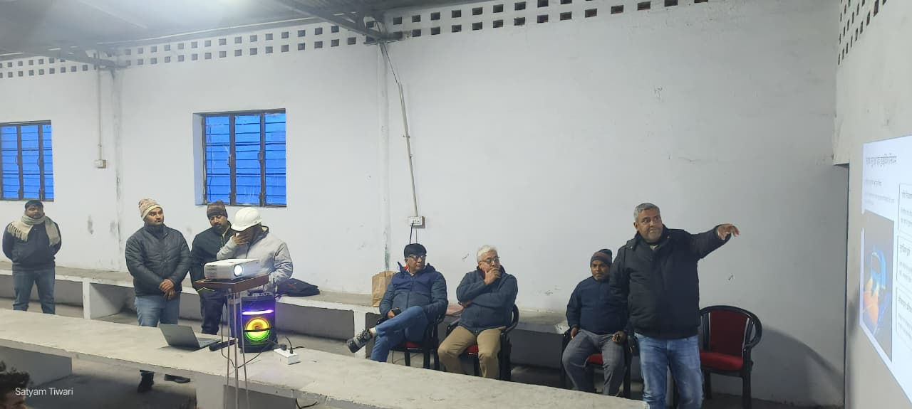
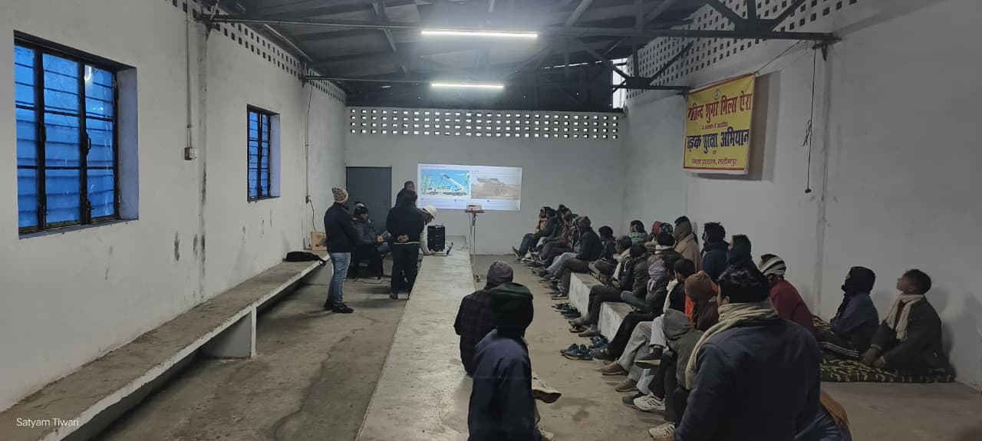
Truck drivers and growers are being given daily safety training for safe driving.

Slide 35
Reason for failure of indent from 10.12.2025 to 16.12.2025

Slide 36
Accidents
Overall Snapshot -Transport
Total recorded accidents: 23
Fatalities: 0
Human injuries: 3 minor injuries (2 women, 1 girl)
Animal casualties/injuries:
1 goat died
1 bull injured
Primary impact: Vehicle damage, cane spillage, operational disruption
Response quality: Immediate cane lifting in almost all cases of toppling/body burst.
Cause Category | Cases
Vehicle imbalance / overturning | 7
Body burst / weak body | 3
Sharp turns / bumpy roads / potholes | 4
Overtaking / driver negligence | 4
Electrical hazards (overhead lines) | 3
Sudden animal / pedestrian movement | 3
Reasons observed
Early morning fog
Village roads with sharp turns
Repeat truck involved
Truck UP 22T 4836 appears twice, Transporter- Madhav Mishra
Three Cane Department ACDOs met with accident in Khamariya due to fog, dog attack and brake failure of the motor bike. No fracture or major injury.

Slide 37
Society & village wise higher indent failure details 10.12.25 to 16.12.25

Slide 38
Reasons for indent failure details 10.12.25 to 16.12.25

Slide 39
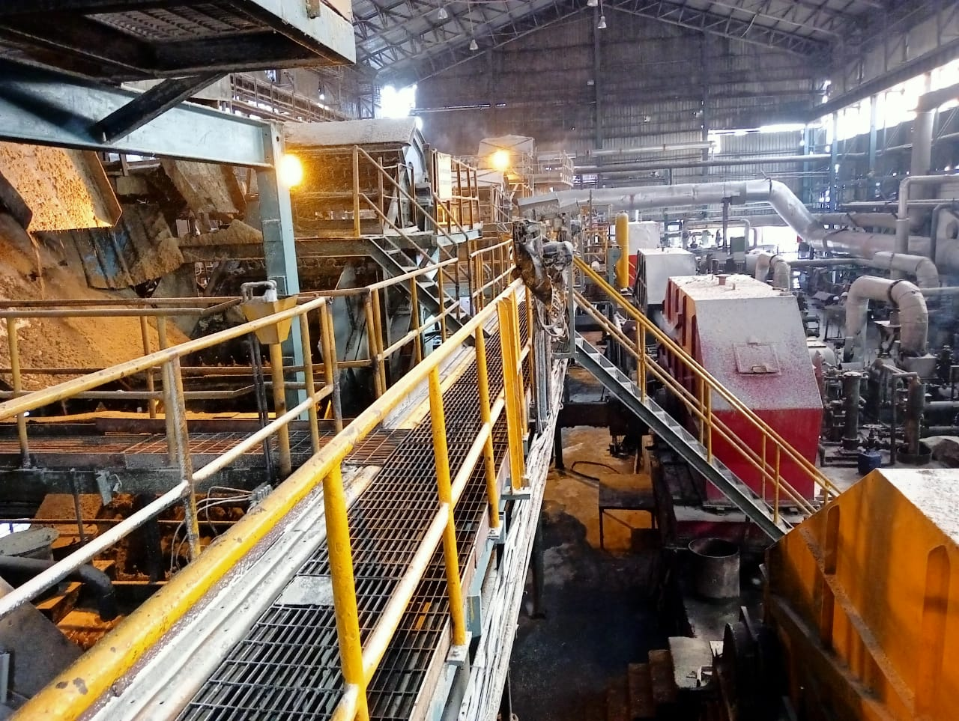
ENGINEERING

Slide 40
Highlights of December 2025
Highest Crush in a Shift: 38129 Qtls.
Highest Crush in a Day: 1.10 L Qtls.
Highest Crush in a Week: 7.51 L Qtls.
Highest Crush in a Month: 32.25 L Qtls.
Highest Crush with one edge of Shredder Tips: 32.45 Lakhs Qtls. (Total 54.24 with both edges)
December Weekly Average Crush Rate: 1.01 (Including Gen Cleaning), 1.054, 1.063, 1.064, 1.047
December Month Average: 104745 Qtls per day
Highest Crush in season 25-26: 1.08 (23.11), 1.085 (29.11) ,1.091 (02.12.), 1.07 (13.12), 1.075 (16.12)
1.075 (22.12), 1.07 (23.12), 1.10 (24.12), 1.07 (25.12), 1.075 (271.2), 1.08 (30.12)

Slide 41
General Observations of the Week
Last week Operation was new experience, 1st time operated above 25 L Qtls with one edge of Tips. Total 32.45 Lakhs Qtls. cane crushed with one edge.
PI after 25 lakhs Qtls. Cane Crushed was 90 ( 25.12) & PI After crush of 31 Lakhs Qtls was 89.29 (02.01.26)
Maximum Load on shredder up to 118x2 on dated 01.01.26
General Cleaning was done on 03.01.26. Planned for 4 Hrs but completed in 8 Hrs
Reason of delay (Crushing stopped at 10.01 am)
Planned to replace Tips but side hammer also found wear out. Tips was replaced at 1 Pm, hammer replacement is about 2 hrs Jobs.
EOT crane out of order from 1.15 pm – 3.30 pm, work was completed with low speed crane.
Particulars | Weekly |  | Till Date
 | SN. 25-26 | SN. 24-25 | SN. 25-26 | SN. 24-25
Hours Worked | 156.07 | 153.37 | 1645.42 | 1641.58
Hours Available | 168.00 | 168.00 | 1680.00 | 1680.00
Hours Utilized (%) | 92.93 | 91.44 | 97.96 | 97.74

Slide 42
Key Operational Parameter- Current Season Vs Last Season
Particulars | Weekly |  | To date
 | SN 25-26 | SN 24-25 | SN 25-26 | SN 24-25
Cane Crushed (In Qtls.) | 691500 | 656700 | 7005700 | 6438900
Rate of Crush | 98786 | 93814 | 100081 | 91984
Pol % Bagasse | 1.71 | 1.74 | 1.75 | 1.77
Loss in Bagasse % Cane | 0.49 | 0.47 | 0.49 | 0.49
Moisture % Bagasse | 50.09 | 49.70 | 50.13 | 50.18
Total Power kw/ Ton of cane | 32.84 | 32.37 | 32.19 | 32.93
Total Power MWH (Sugar) | 11.37 | 10.43 | 10.99 | 10.04
Lubricant Consumption. | 0.04 | 0.04 | 0.04 | 0.04

Slide 43
Weekly Performance Snapshot - Engineering
S.No. | Capacity Utilization | Target 2025-26 | Current Week. 28.12.25 to 03.01.2026) | Last Week | Till Date (03.01.2026)
1 | Cane Crushed (LQ) (192 Days) | 179.00 | 6.915 | 7.51 | 70.057
2 | Hours Utilized (%) | 99.17 | 92.93 | 99.68 | 97.96
3 | Downtime (Hrs.) | 72.00 | 3.53 | 0.32 | 19.02
4 | Planned Stoppage (Hrs.) | 48.00 | 8.00 | 0.00 | 18.08
5 | Forced Shutdown (Hrs.) | 24.00 | 3.53 | 0.32 | 13.14
6 | Capacity Utilization in Uptime @ 1 LQ / Day Base (%) | 94.71 | 106.31 | 107.63 | 102.17
7 | Capacity Utilization incl. Stoppage (%) | 93.22 | 98.79 | 107.29 | 100.08
 | Quality
1 | Pol % Bagasse | 1.65 - 1.70 | 1.71 | 1.71 | 1.75
2 | Moisture % Bagasse | 49 - 49.5 | 50.09 | 50.14 | 50.13
 | Consumption
1 | Steam Consumption (KG/Qtl Cane) | 5.0-6.0 | 5.13 | 4.78 | 4.93
2 | Power Consumption (KW/T Cane) | 31.5 - 32 | 33.84 | 32.20 | 32.19
3 | Lubricant Consumption (Kg/100 Qtl Cane) | 0.04 | 0.04 | 0.04 | 0.04
43

Slide 44
Monthly figure
Plant Performance in Season 25-26
Sr No | Particulars | Unit | Season 25-26
 |  |  | Target | Achieved (03.01.2026)
1 | Total Cane Crushed | Qtls | 17900000 | 7005700
2 | Date of Start | Date | 20/10/2025 | 26/10/2025
3 | Date of Finish | Date | 23/04/2026 | -
4 | Gross Season Days | Nos | 192 | 70
5 | Crushing rate Including Stoppage | Qtls | 93229 | 100081
6 | Crushing rate Excluding stoppage | Qtls | 94709 | 102168
7 | Capacity Utilization | % | 94.71 | 102.17
8 | Total Stoppage Hours | Hrs. | 72.00 | 34.18
9 | Planned Shutdown | Hrs. | 48.00 | 18.08
10 | Forced Shutdown | Hrs. | 24:00 | 13.14
11 | Preparatory index | % | 90.0-91.0 | 90.26
12 | Primary Extraction | % | 70.5-71.0 | 71.34
13 | Mill Extraction ( ME) | % | 96 - 96.5 | 95.93
14 | Reduced mill Extraction (RME) | % | 96.4 - 96.80 | 96.19
15 | Bagasse % Cane | % | 29.00 | 27.93
16 | Pol % Bagasse | % | 1.65-1.70 | 1.75
17 | Moisture % Bagasse | % | 49.0 - 49.5 | 50.13
18 | Imbibition % Cane | % | 40 Max | 36.79
19 | Imbibition % Fibre | % | 290 - 295 | 277.95
20 | Dry Milling Factor | % | 71.25 | 71.65
21 | Grease & Lubricants Kg/100 Qtls Cane | % | 0.04 | 0.04
22 | Power Consumption ( KW/T Cane) | % | 31.5 - 32 | 32.19
23 | Steam Consumption Sugar (Kg/Q of Cane) | % | 5.0-6.0 | 4.90
44

Slide 45
Stoppages, Actions & RCA for the Week
Stoppage Details Crushing Season 2025-26
S NO | Report Date | Head | Section | Equipment Name | Type | From | To | Duration in Hrs | Stoppages Reason
94 | 28/12/2025 | Mechanical | Cane Handling | Cane Carrier | Tripped | 28/12/2025 15:09 | 28/12/2025 15:13 | 0:04 | Main Cane Carrier motor stalled due to overload
95 | 28/12/2025 | Mechanical | SRC & IRC | IRC No-4 | Forced Shutdown | 28/12/2025 23:37 | 29/12/2025 01:15 | 1:38 | IRC No-4 overload due to Donnelly chute level high.
96 | 28/12/2025 | Mechanical | SRC & IRC | IRC No-1 | Tripped | 29/12/2025 04:15 | 29/12/2025 04:19 | 0:04 | IRC No-1 tripped due to overload.
97 | 29/12/2025 | Mechanical | Mill | Mill No-4 | Forced Shutdown | 29/12/2025 12:57 | 29/12/2025 13:05 | 0:08 | Mill No-4 Donnelly chute level high.
98 | 29/12/2025 | Mechanical | SRC & IRC | IRC No-4 | Forced Shutdown | 29/12/2025 14:07 | 29/12/2025 14:15 | 0:08 | IRC No-4 Scrapper extended (as existingfound wear out)
99 | 30/12/2025 | Mechanical | Cane Handling | Cane Carrier | Tripped | 31/12/2025 05:17 | 31/12/2025 05:20 | 0:03 | Main Cane Carrier motor stalled due to overload
100 | 31/12/2025 | Mechanical | Cane Handling | Cane Carrier | Tripped | 31/12/2025 11:15 | 31/12/2025 11:35 | 0:20 | Main Cane Carrier motor stalled due to overload
101 | 31/12/2025 | Mechanical | Cane Preparation | In Line Shredder | Forced Shutdown | 01/01/2026 05:15 | 01/01/2026 06:16 | 1:01 | Broken bolt replaced of Shrdder Coupling
102 | 02/01/2026 | Mechanical | Cane Handling | Cane Carrier | Tripped | 02/01/2026 10:07 | 02/01/2026 10:22 | 0:15 | Main Cane Carrier motor stalled due to overload
103 | 02/01/2026 | Mechanical | Cane Preparation | In Line Shredder | Tripped | 02/01/2026 20:04 | 02/01/2026 20:10 | 0:06 | Shredder Motor tripped due to Low lub oil pressure
104 | 02/01/2026 | Mechanical | Cane Preparation | In Line Shredder | Tripped | 02/01/2026 20:29 | 02/01/2026 20:35 | 0:06 | Shredder Motor tripped due to Low lub oil pressure (False Signal)
105 | 03/01/2026 | General Cleaning | Scheduled Stoppage | General Cleaning | General Cleaning | 03/01/2026 10:00 | 03/01/2026 18:00 | 8:00 | Scheduled stoppage for general cleaning ( Shredder Tip replaced by new & Mill No-1 Top scrapper Replaced
Note: To control the overloading on feeder drum, a hooter with light provided at kicker on dated 18.12.25, positive result seen but still its under observation

Slide 46


FORCED OUTAGE IRC 4 Overload
DATED 28.12.2025
SEQUENCE OF EVENT :
OUTAGE IMPACT : Crushing Stopped for 1.38 Hrs 23.37-1.15)
Immediate Action Taken: Jammed bagasse Cleared, Bend scrapper of IRC set right & started.
Final Remedial Action: Arcing done of Rollers
Attachment- DCS Trend
REASON OF FAILURE
DESCRIPTION | REMARK
Mill RPM Low | NO
Excess Loading- Mill | NO
Excess Loading- IRC 4 | NO
DC level high- any chocking in Mill | NO
DC Level high- Slippage of bagasse over roller | Yes
Initially Mill no 4 Donally chute level high
IRC No 4 level high and over loaded

Slide 47
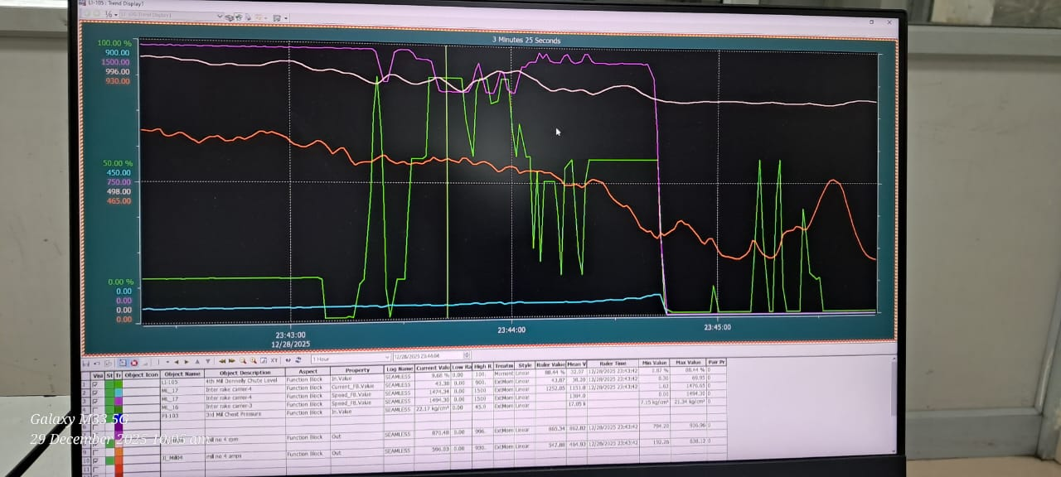
FORCED OUTAGE IRC 4 Overload
DATED 28.12.2025

Slide 48
FORCED OUTAGE Shredder Coupling Bolts Broken
DATED 31.12.2025
SEQUENCE OF EVENT :
OUTAGE IMPACT : Crushing Stopped for 1.01 Hrs (o5.15 am-06.16 am)
Immediate Action Taken: New Bolts Fitted. All Carbon brush checked, all other bolts Checked
Final Remedial Action: Checked on 03.01.26 during General Cleaning, No abnormalities found
Attachment- DCS Trend
REASON OF FAILURE
DESCRIPTION | REMARK
Vibration Increased | NO
Load Increased | NO
Aged of bolts | NO
Misalignment | NO
Impact Loading | Yes
Motor Current unbalance observed
Shredder Stopped immediately

Slide 49
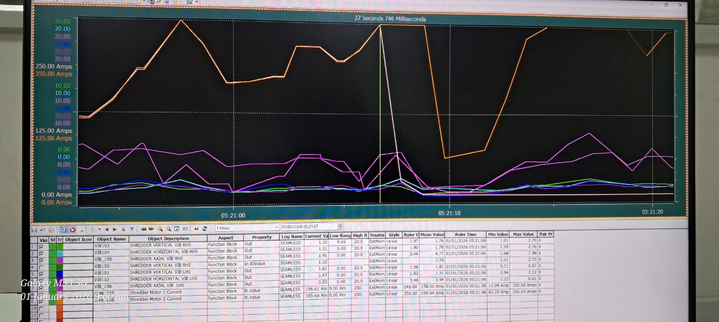
FORCED OUTAGE Shredder Coupling Bolts Broken
DATED 31.12.2025

Slide 50
Stoppages Till 03.01.2026 CONPARETIVE SUMMARY - INCIDENCE REPORT OF MILL STOPPAGE
S.NO | PARTICULAR | SEASON 2019-20 | SEASON 2020-21 | SEASON 2021-22 | SEASON 2022-23 | SEASON 2023-24 | SEASON 2024-25 | SEASON 2025-26
A | MECHANICAL STOPPAGE DETAILS
1 | CANE UNLOADER | 00:00:00 | 00:45:00 | 00:13:00 | 00:15:00 | 00:00:00 | 00:00:00 | 00:00:00
2 | CANE CARRIER | 68:17:00 | 01:51:00 | 08:48:00 | 07:19:00 | 00:18:00 | 01:56:00 | 00:58:00
3 | CANE JAMMING NEAR CANE KICKER | 01:01:00 | 00:52:00 | 00:00:00 | 00:19:00 | 00:00:00 | 00:28:00 | 00:00:00
4 | FEEDER DRUM TRIPPED | 02:40:00 | 02:07:00 | 00:08:00 | 00:00:00 | 00:17:00 | 01:46:00 | 02:02:00
5 | SHREDDER | 01:39:00 | 07:31:00 | 00:40:00 | 38:46:00 | 105:00:00 | 02:29:00 | 03:33:00
6 | SHREDDER KICKER | 03:28:00 | 00:00:00 | 00:00:00 | 00:00:00 | 00:00:00 | 00:00:00 | 00:00:00
7 | CANE BELT CONVEYOR | 00:12:00 | 01:10:00 | 00:00:00 | 00:00:00 | 12:48:00 | 00:12:00 | 00:00:00
8 | RAKE CARRIER & INTER CARRIER | 26:35:00 | 05:00:00 | 17:43:00 | 09:30:00 | 09:08:00 | 03:13:00 | 05:53:00
9 | MILLS | 04:30:00 | 20:56:00 | 08:01:00 | 02:00:00 | 03:54:00 | 00:34:00 | 00:21:00
10 | DONALLY CHUTE | 00:00:00 | 10:26:00 | 06:29:00 | 02:22:00 | 00:50:00 | 01:58:00 | 00:08:00
11 | JUICE TRAY JAMMING | 00:00:00 | 01:38:00 | 00:00:00 | 00:00:00 | 00:00:00 | 00:00:00 | 00:00:00
12 | TURBINE | 03:28:00 | 00:50:00 | 01:29:00 | 00:00:00 | 00:24:00 | 00:00:00 | 00:29:00
13 | BOILING HOUSE | 03:57:00 | 00:00:00 | 05:21:00 | 00:49:00 | 01:15:00 | 00:00:00 | 00:00:00
14 | TOTAL MACHENICAL (MILL & BH) | 115:47:00 | 53:06:00 | 48:52:00 | 61:20:00 | 133:54:00 | 12:36:00 | 13:24:00
B | TOTAL STOPPAGE DETAILS
1 | NO CANE | 162:44:00 | 101:22:00 | 63:23:00 | 43:36:00 | 42:40:00 | 32:55:00 | 0:00:00
2 | WEATHER | 00:00:00 | 00:00:00 | 20:39:00 | 00:00:00 | 00:00:00 | 0:00:00 | 0:00:00
3 | CRUSH REDUCE | 00:00:00 | 01:51:00 | 02:43:00 | 04:05:00 | 15:55:00 | 0:00:00 | 0:00:00
4 | MECHANICAL | 115:47:00 | 53:10:00 | 48:52:00 | 61:20:00 | 135:54:00 | 12:36:00 | 8:59:00
5 | PROCESS | 00:40:00 | 00:24:00 | 02:00:00 | 00:00:00 | 00:00:00 | 0:00:00 | 0:00:00
6 | GENERAL CLEANING | 41:31:00 | 45:05:00 | 54:09:00 | 97:53:00 | 58:04:00 | 35:15:00 | 4:20:00
7 | GROWER STRIKE | 56:48:00 | 12:00:00 | 00:00:00 | 00:00:00 | 00:00:00 | 0:00:00 | 0:00:00
8 | MISE | 20:39:00 | 00:55:00 | 02:40:00 | 00:45:00 | 02:41:00 | 4:37:00 | 6:04:00
9 | ELECTRICAL | 05:29:00 | 04:45:00 | 03:00:00 | 11:33:00 | 02:13:00 | 9:12:00 | 0:20:00
10 | BOILER | 23:00:00 | 11:59:00 | 06:23:00 | 29:48:00 | 00:26:00 | 2:53:00 | 2:10:00
11 | INSTRUMENT | 00:56:00 | 00:30:00 | 00:00:00 | 00:12:00 | 02:04:00 | 0:18:00 | 0:00:00
12 | TOTAL STOPPAGE | 427:34:00 | 232:01:00 | 203:49:00 | 249:12:00 | 259:57:00 | 97:46:00 | 21:53:00

Slide 51
Monthly Comparative Data (Season 2023-24 to 2025-26)
Sr No | Particulars | Unit | Season 2025-26 | Season 2024-25 | Season 2025-26 | Season 2024-25
 |  |  | November | November | December | December
1 | Total Cane Crushed | Qtls | 3055700 | 2777600 | 3247100 | 3062400
2 | Gross Season Days | Nos | 30 | 30 | 31 | 31
3 | Crushing rate Including Stoppage | Qtls | 101857 | 92587 | 104745 | 98787
4 | Crushing rate Excluding stoppage | Qtls | 103620 | 93877 | 106419 | 100877
5 | Total Hrs Available | Hrs | 720:00 | 720 | 744:00:00 | 744:00:00
6 | Days Worked | Nos | 29.49 | 29.59 | 30.51 | 30.36
7 | Hrs Worked | Hrs | 707:45 | 710.10 | 732:18:00 | 728:35:00
8 | Capacity Utilization | % | 98.30 | 98.63 | 98.43 | 97.93
9 | Total Stoppage Hours | Hrs. | 12:15 | 9.50 | 11:42:00 | 15:25
10 | Above 100000 Qtls Cane Crushing | Days | 25 | 19 | 30 | 22
11 | Highest Cane Crushing in Days | Qtls | 108500 | 102000 | 110000 | 104000
12 | Mill Extraction ( ME) | % | 95.61 | 95.38 | 96.26 | 96.31
13 | Reduced mill Extraction (RME) | % | 71.74 | 95.77 | 71.61 | 96.46
14 | Bagasse % Cane | % | 27.83 | 28.12 | 27.95 | 27.04
15 | Pol % Bagasse | % | 1.76 | 1.80 | 1.71 | 1.72
16 | Moisture % Bagasse | % | 50.18 | 50.34 | 50.05 | 49.73
17 | Imbibition % Cane | % | 35.63 | 37.05 | 38.15 | 38.24
18 | Imbibition % Fibre | % | 270.47 | 268.78 | 286.85 | 295.45
19 | Dry Milling Factor | % | 71.74 | 71.44 | 71.61 | 72.52
20 | Grease & Lubricants Kg/100 Qtls Cane | % | 0.04 | 0.04 | 0.06 | 0.04
21 | Power Consumption ( KW/T Cane) | % | 32.21 | 33.07 | 32.05 | 32.71

Slide 52
Sugar Power Consumption Breakup ( MWH) 03.12.2025 to 27.12.2025
Comparative data for Cane Crushed , Power Generation , Export and SPE Division Power Consumption of Year 24-25 Vs 25-26
Date | Cane Crushed (MT) |  |  | Sugar Power Consumption Breakup
 |  |  |  | SHREDDER-1&2 (MW/Hrs.) |  | Zero & 4th Mill (MW/Hrs.) |  | DS House (MW/Hrs.) |  | Raw & Ref. House (MW/Hrs.)
 | 24-25 | 25-26 |  | 24-25 | 25-26 | 24-25 | 25-26 | 24-25 | 25-26 | 24-25 | 25-26
3-Dec | 10080 | 7550 |  | 3.67 | 2.18 | 0.89 | 0.69 | 2.27 | 1.88 | 2.32 | 1.88
4-Dec | 10100 | 10500 |  | 3.67 | 2.82 | 0.88 | 0.95 | 2.38 | 2.41 | 2.31 | 2.48
5-Dec | 9750 | 10550 |  | 3.69 | 2.87 | 0.88 | 0.98 | 2.35 | 2.50 | 2.33 | 2.54
6-Dec | 9720 | 10550 |  | 3.58 | 2.96 | 0.85 | 1.00 | 2.26 | 2.51 | 2.29 | 2.45
7-Dec | 9600 | 10500 |  | 3.65 | 3.00 | 0.85 | 0.98 | 2.32 | 2.49 | 2.22 | 2.48
8-Dec | 10100 | 10450 |  | 3.55 | 3.07 | 0.84 | 0.97 | 2.32 | 2.43 | 2.43 | 2.44
9-Dec | 10100 | 10550 |  | 3.72 | 3.20 | 0.90 | 0.99 | 2.24 | 2.46 | 2.32 | 2.50
10-Dec | 9500 | 10550 |  | 3.87 | 3.35 | 0.92 | 0.99 | 2.29 | 2.47 | 2.28 | 2.48
11-Dec | 10020 | 10600 |  | 3.55 | 3.46 | 0.84 | 0.96 | 2.30 | 2.46 | 2.28 | 2.48
12-Dec | 6500 | 10300 |  | 3.78 | 3.49 | 0.91 | 0.94 | 1.80 | 2.42 | 1.83 | 2.45
13-Dec | 10020 | 10700 |  | 1.88 | 3.62 | 0.58 | 0.94 | 2.19 | 2.52 | 2.21 | 2.42
14-Dec | 10100 | 10600 |  | 2.98 | 3.80 | 0.89 | 0.98 | 2.26 | 2.41 | 2.31 | 2.42
15-Dec | 10140 | 10550 |  | 3.06 | 3.71 | 0.89 | 0.93 | 2.28 | 2.56 | 2.26 | 2.52
16-Dec | 9810 | 10750 |  | 3.07 | 3.81 | 0.84 | 0.96 | 2.34 | 2.45 | 2.22 | 2.45
17-Dec | 9310 | 10600 |  | 2.96 | 3.86 | 0.76 | 0.96 | 2.29 | 2.32 | 2.26 | 2.31
18-Dec | 10000 | 10600 |  | 3.21 | 3.79 | 0.84 | 0.93 | 2.32 | 2.36 | 2.33 | 2.38
19-Dec | 10150 | 10650 |  | 3.25 | 3.92 | 0.86 | 0.95 | 2.37 | 2.35 | 2.35 | 2.38
20-Dec | 10170 | 10600 |  | 3.38 | 3.89 | 0.87 | 0.74 | 2.42 | 2.38 | 2.42 | 2.50
21-Dec | 10110 | 10650 |  | 3.32 | 3.95 | 0.85 | 1.13 | 2.49 | 2.18 | 2.46 | 2.23
22-Dec | 10170 | 10750 |  | 3.51 | 4.04 | 0.87 | 0.94 | 2.34 | 2.31 | 2.34 | 2.31
23-Dec | 10150 | 10700 |  | 3.49 | 4.02 | 0.87 | 0.92 | 2.47 | 2.27 | 2.39 | 2.35
24-Dec | 10320 | 11000 |  | 3.65 | 4.14 | 0.86 | 0.93 | 2.27 | 2.33 | 2.38 | 2.34
25-Dec | 9380 | 10700 |  | 3.46 | 4.11 | 0.81 | 0.94 | 2.32 | 2.38 | 2.21 | 2.43
26-Dec | 10220 | 10550 |  | 3.70 | 4.14 | 0.86 | 0.93 | 2.40 | 2.39 | 2.39 | 2.45
27-Dec | 10340 | 10750 |  | 3.75 | 4.11 | 0.87 | 0.93 | 2.39 | 2.36 | 2.45 | 2.43

Slide 53
Sugar Power Consumption Breakup ( MWH) Week 21.12.2025 to 27.12.2025
Comparative data for Cane Crushed , Power Generation , Export and SPE Division Power Consumption of Year 24-25 Vs 25-26
Date | Cane Crushed (MT) |  | Sugar Power Consumption Breakup
 |  |  | SHREDDER-1&2 (MW/Hrs.) |  | Zero & 4th Mill (MW/Hrs.) |  | DS House (MW/Hrs.) |  | Raw & Ref. House (MW/Hrs.) |  | Total Power Consumption-Sugar
 | 24-25 | 25-26 | 24-25 | 25-26 | 24-25 | 25-26 | 24-25 | 25-26 | 24-25 | 25-26 | 24-25 | 25-26
28-Dec | 102300 | 100000 | 3.75 | 3.97 | 0.86 | 0.90 | 2.22 | 2.09 | 2.27 | 2.43 | 11.26 | 11.64
29-Dec | 102000 | 106000 | 3.83 | 4.06 | 0.86 | 0.88 | 2.19 | 2.36 | 2.29 | 2.36 | 11.22 | 11.96
30-Dec | 102300 | 108000 | 3.79 | 4.27 | 0.87 | 0.90 | 2.19 | 2.35 | 2.32 | 2.36 | 11.39 | 12.12
31-Dec | 92200 | 100000 | 3.43 | 4.08 | 0.79 | 0.85 | 2.14 | 2.30 | 2.28 | 2.31 | 10.73 | 11.85
01-Jan | 100200 | 106500 | 3.70 | 4.35 | 0.86 | 0.90 | 2.19 | 2.28 | 2.23 | 2.27 | 11.10 | 12.01
02-Jan | 94200 | 101500 | 3.70 | 4.14 | 0.87 | 0.84 | 2.01 | 2.30 | 2.02 | 2.36 | 10.71 | 11.83
03-Jan | 61400 | 69500 | 1.58 | 2.07 | 0.51 | 0.60 | 1.79 | 1.87 | 1.86 | 1.87 | 7.52 | 8.18

Slide 54
Milling Data (28.12.2025 to 03.01.2026)
Crop Day | Date | Cane Crush in Qlts |  | Av Crush Rate Excl Stopp |  | Imbibition % Fiber |  | Maceration % Cane |  | Bag Pol |  | Bag Moisture |  | Power kw / T Cane |  | Stoppage
 |  | On date | To date | On Day | To date | On date | To date | On date | To date | On date | To date | On date | To date | On date | To date | To date | Remarks
 | Target | 93229 | 17900000 |  |  | 290-295 |  | 40% Max |  | 1.65-1.70 |  | 49.00-49.5 |  | 31.50-32.00 |  | 72
64 | 28/12/2025 | 100000 | 6414200 | 107946 | 101825 | 288.45 | 277.02 | 38.68 | 36.60 | 1.68 | 1.75 | 50.02 | 50.14 | 34.04 | 32.06 | 34:18 | MCC tripped due to overload, IRC no-4 overload due to Donnelly chute level high & IRC No-1tripp due to high load
65 | 29/12/2025 | 106000 | 6520200 | 107191 | 101909 | 287.84 | 277.21 | 38.81 | 36.64 | 1.69 | 1.75 | 50.17 | 50.14 | 32.76 | 32.07 |  | Mil No-4 Donnelly chute level high & IRC No-4 Scrapper Extended (as xisting foundwear out)
66 | 30/12/2025 | 108000 | 6628200 | 108226 | 102006 | 285.04 | 277.34 | 38.71 | 36.67 | 1.71 | 1.75 | 49.88 | 50.13 | 32.50 | 32.08 |  | Main Cane Carrier motor stalled due to overload
67 | 31/12/2025 | 100000 | 6728200 | 105960 | 102061 | 286.65 | 277.45 | 38.79 | 36.70 | 1.70 | 1.75 | 49.92 | 50.11 | 34.53 | 32.11 |  | Main Cane Carrier motor stalled due to overload Broken bolt replaced of Shtrdder Coupling
68 | 01/01/2026 | 106500 | 6834700 | 106500 | 102128 | 288.89 | 277.66 | 39.07 | 36.74 | 1.70 | 1.75 | 50.05 | 50.13 | 32.66 | 32.12 |  | 0
69 | 02/01/2026 | 101500 | 6936200 | 103440 | 102147 | 288.38 | 277.82 | 39.21 | 36.78 | 1.70 | 1.75 | 50.20 | 50.13 | 33.95 | 32.15 |  | Main Cane Carrier motor stalled due to overload & Shredder motor tripped due to lub oil pressure low.
70 | 03/01/2026 | 69500 | 7005700 | 104250 | 102168 | 292.37 | 277.95 | 38.73 | 36.79 | 1.76 | 1.75 | 50.42 | 50.13 | 36.41 | 32.19 |  | Shredder Tip Replaced by New.

Slide 55
Vibration & Motor Power Data for Shredder Rotor (28.12.2025 to 03.01.2026)
Crop Day | Date | Crush |  | Shredder Vibration & Bearing Temp ( LHS ) -1 |  |  |  |  | Shredder Vibration & Bearing Temp (RHS)-2
 |  | On date | To date | Motor LHS Power | Brg Temp (Avg) | V (Avg) | H (Avg) | A (Avg) | Motor RHS Power | Brg Temp (Avg) | V (Avg) | H (Avg) | A (Avg)
64 | 28/12/2025 | 100000 | 6414200 | 107.38 | 58.92 | 1.47 | 1.55 | 2.63 | 105.63 | 54.62 | 1.50 | 1.39 | 2.53
65 | 29/12/2025 | 106000 | 6520200 | 114.40 | 58.86 | 1.72 | 1.59 | 2.98 | 112.68 | 54.77 | 1.51 | 1.34 | 2.84
66 | 30/12/2025 | 108000 | 6628200 | 117.80 | 58.65 | 1.48 | 1.37 | 2.62 | 116.48 | 55.49 | 1.42 | 1.14 | 2.71
67 | 31/12/2025 | 100000 | 6728200 | 115.46 | 58.19 | 1.60 | 1.40 | 2.91 | 114.18 | 53.66 | 1.42 | 1.18 | 2.91
68 | 01/01/2026 | 106500 | 6834700 | 118.11 | 58.81 | 1.44 | 1.40 | 2.54 | 117.52 | 54.80 | 1.33 | 1.16 | 2.70
69 | 02/01/2026 | 101500 | 6936200 | 115.30 | 57.25 | 1.50 | 1.30 | 2.91 | 115.26 | 53.67 | 1.41 | 1.08 | 2.59
70 | 03/01/2026 | 69500 | 7005700 | 56.17 | 45.06 | 0.99 | 0.90 | 2.54 | 56.02 | 44.96 | 0.95 | 0.79 | 2.31

Slide 56
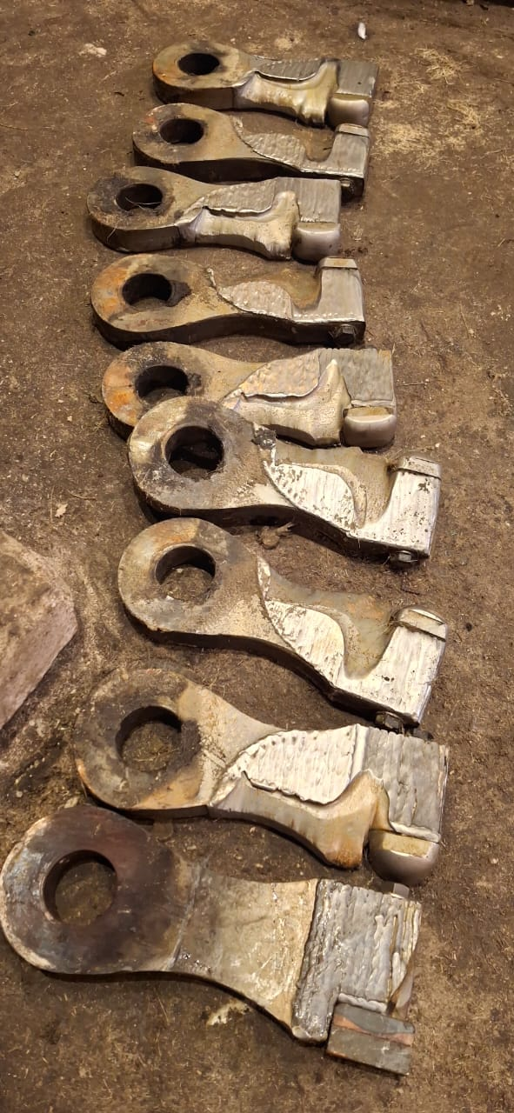
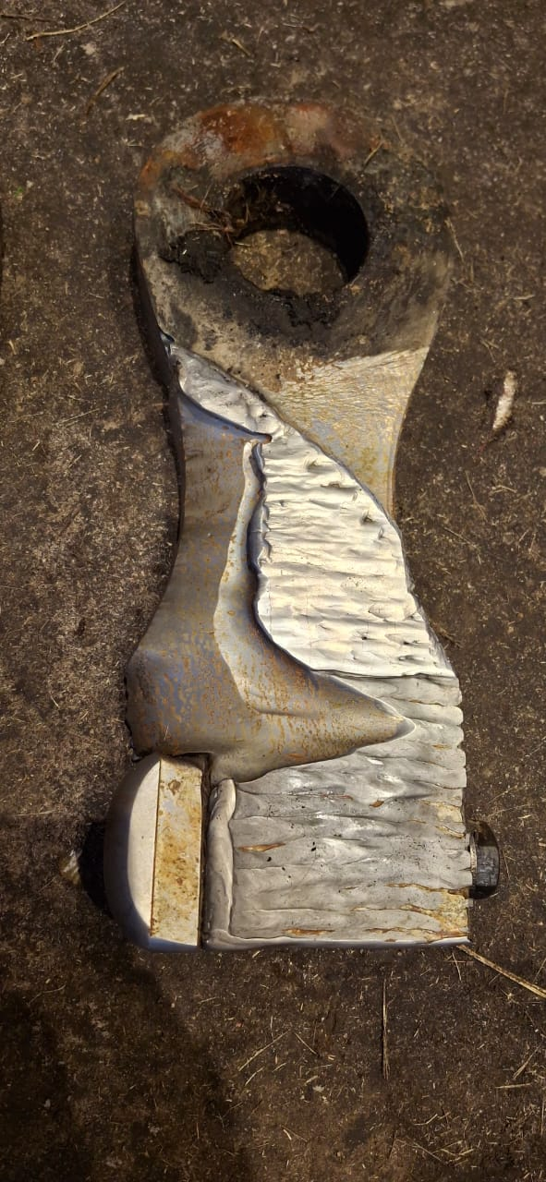
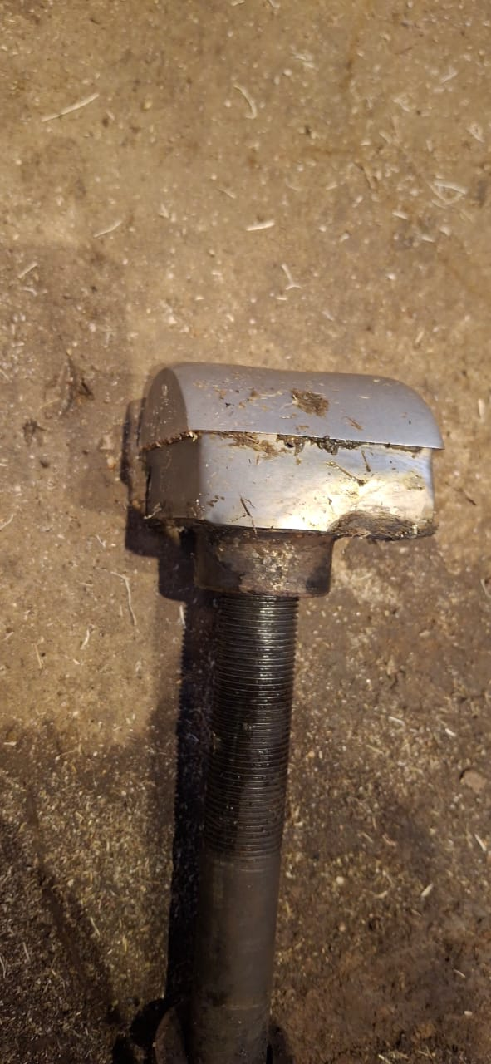
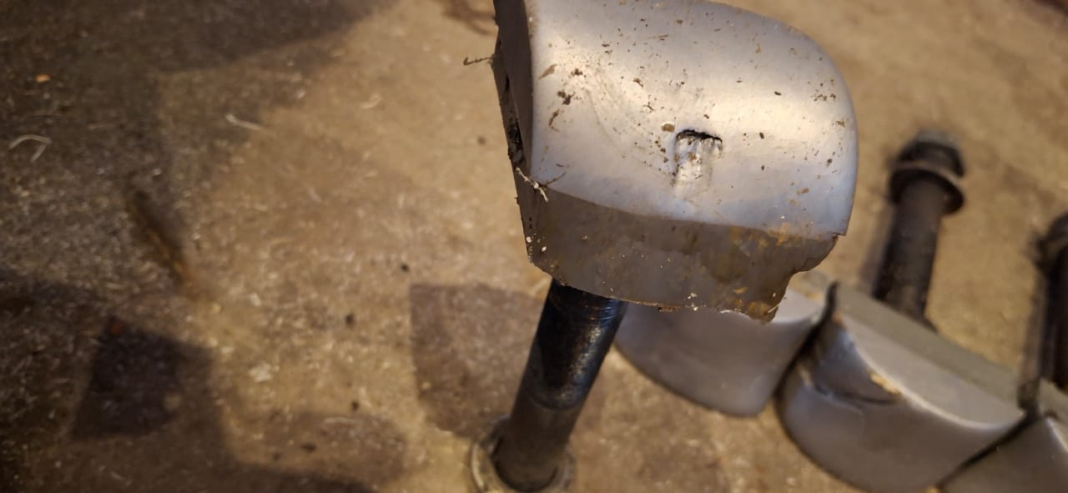
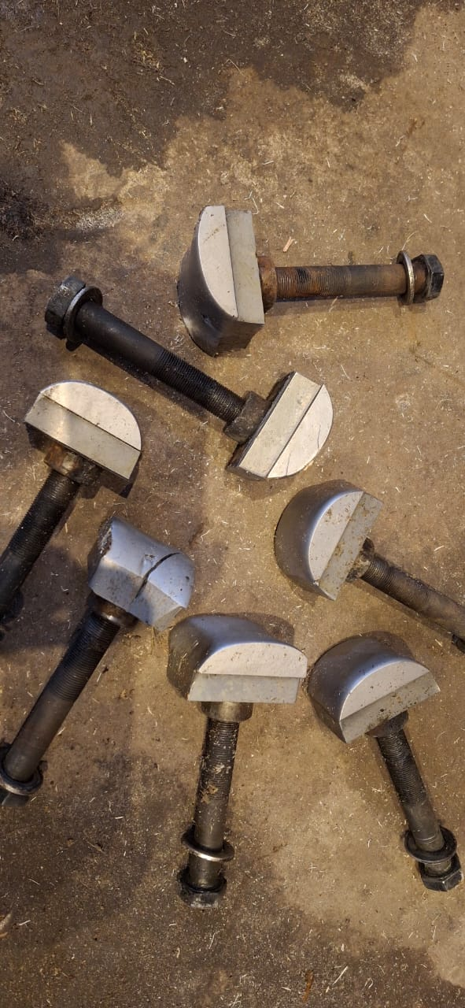
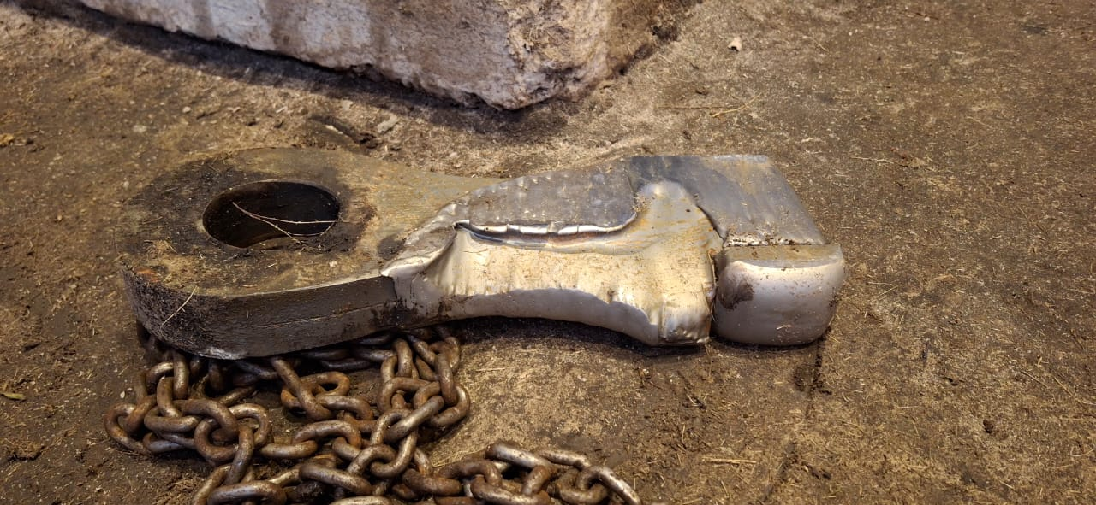
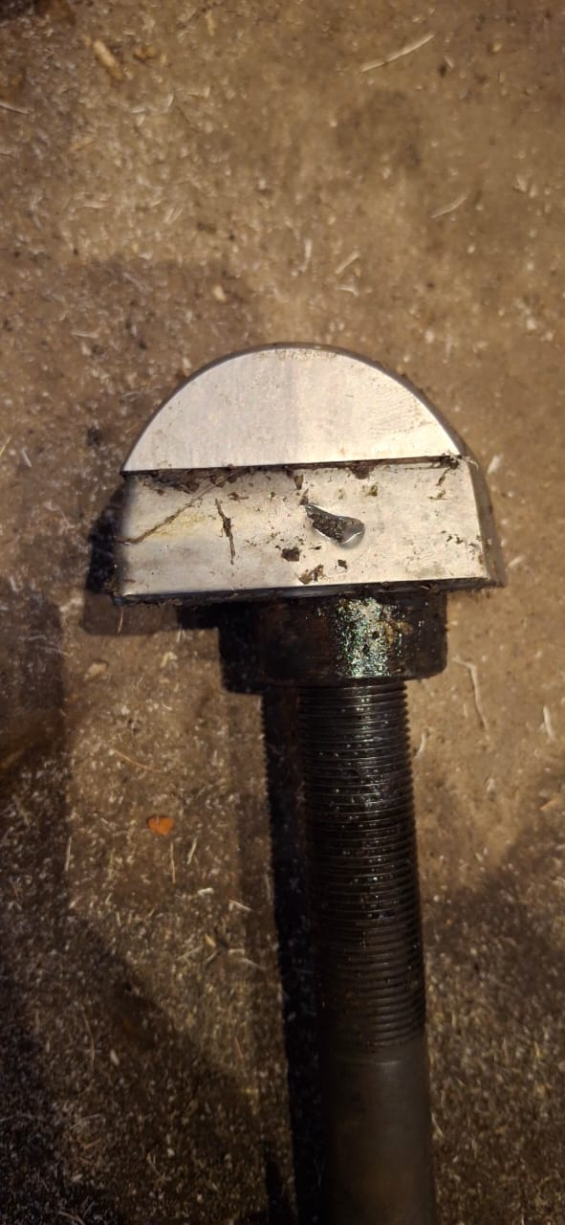
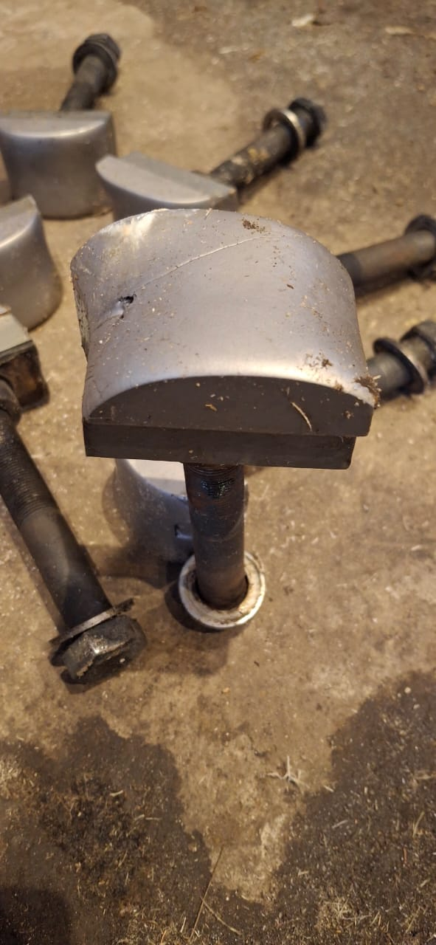
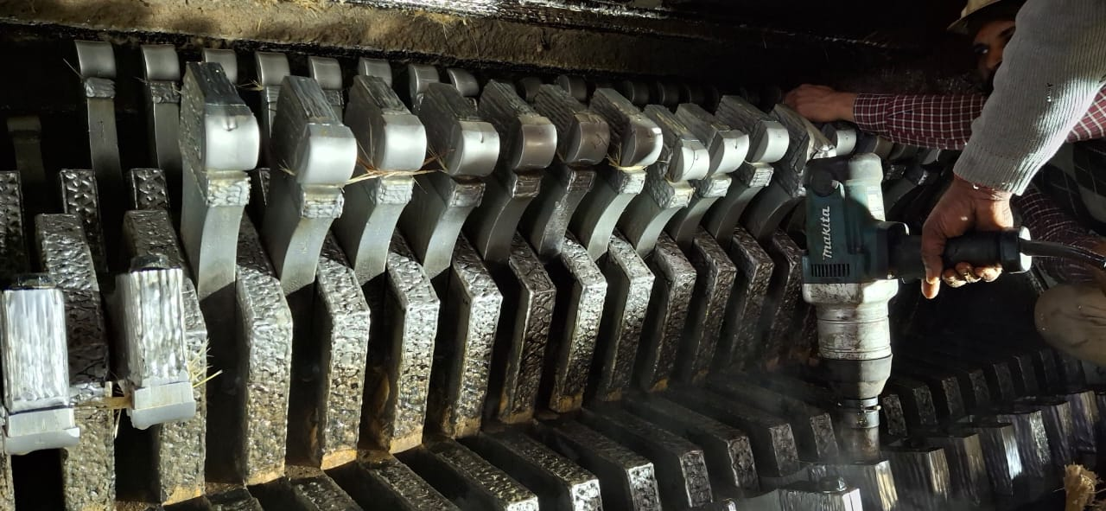
General Cleaning Major Jobs
Shredder Hammer & Tips Condition
All Tips Replaced with New (proposed extended life) and 08 nos. side hammer replaced including one intermediate hammer

Slide 57
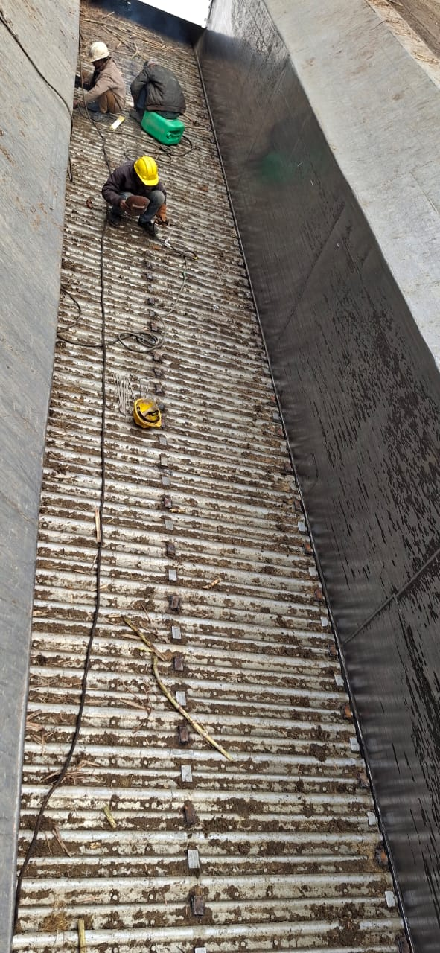
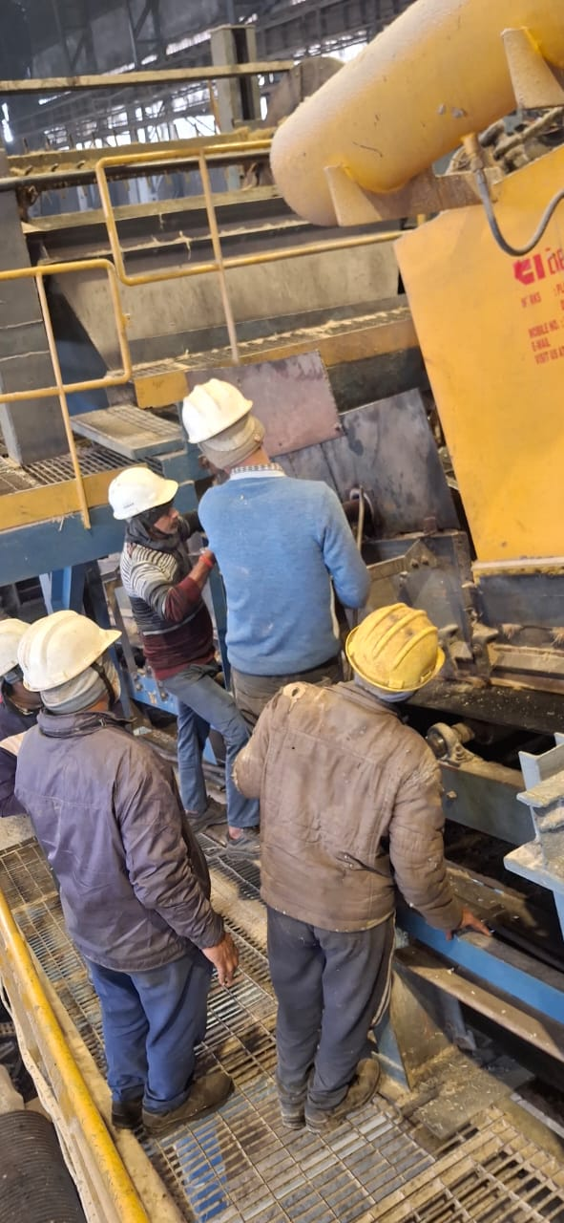
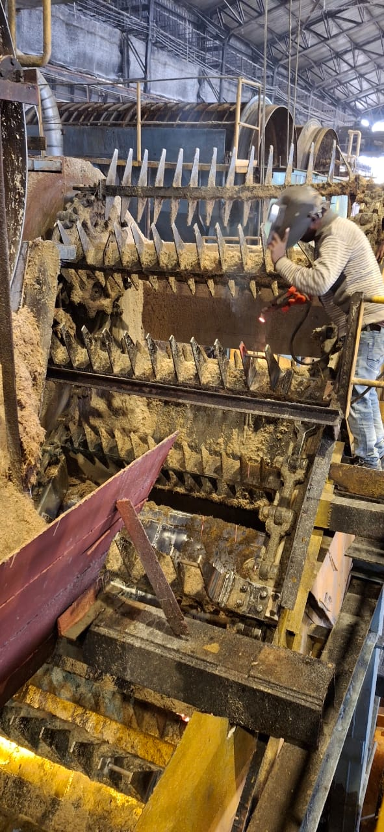
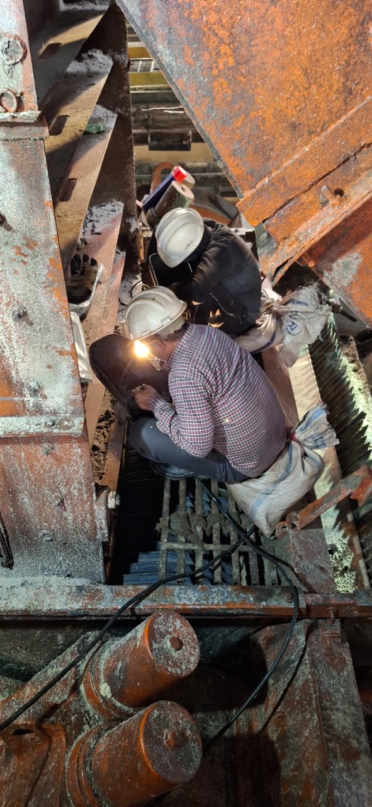
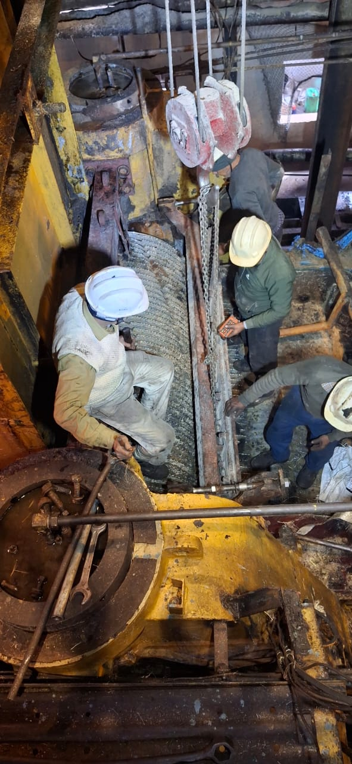
General Cleaning Major Jobs
Roller Arcing
MCC- Wear out pad buildup
Comber: Clearance Increased
IRC’s: Missing bolts fitted & bend figure made straight
M1- Top scrapper Replaced

Slide 58
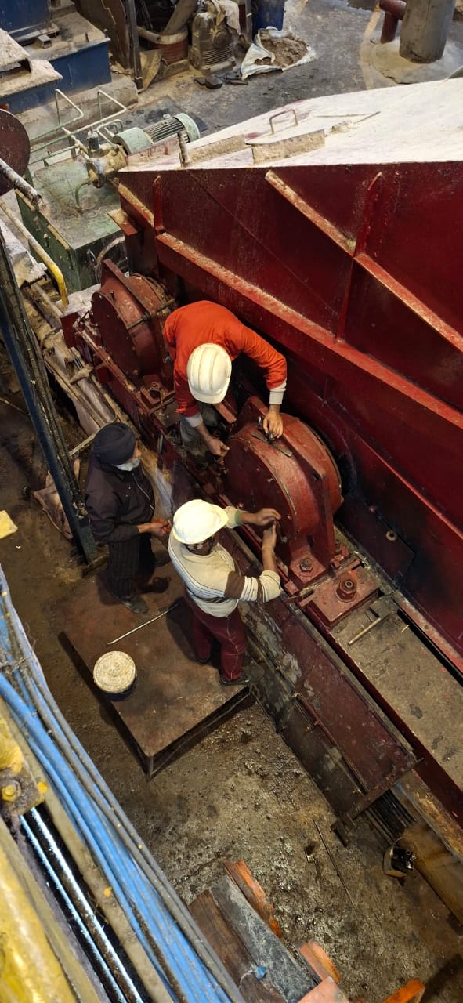
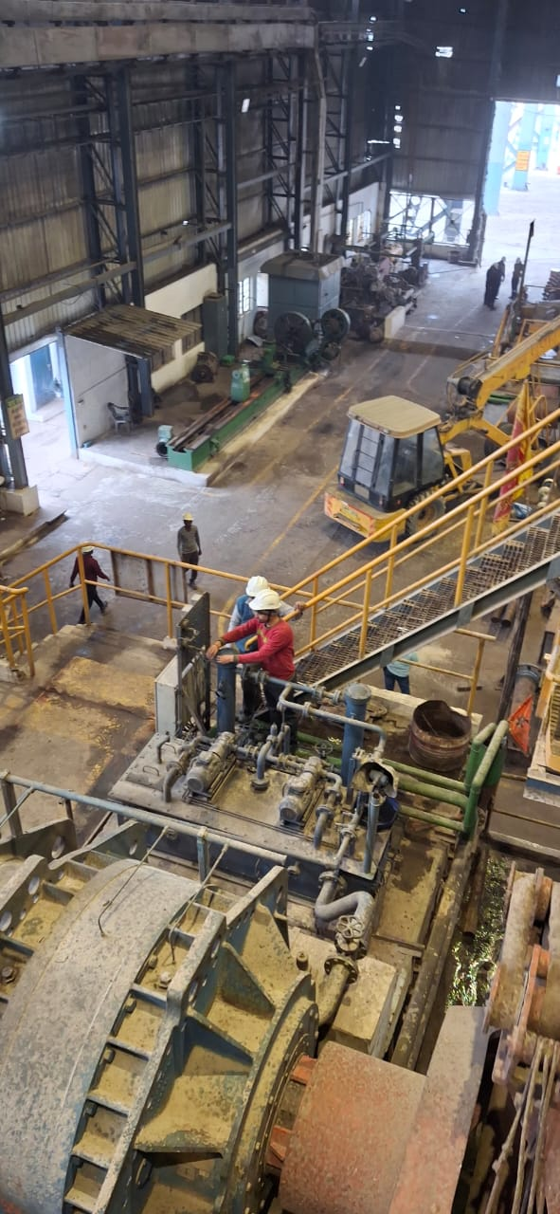
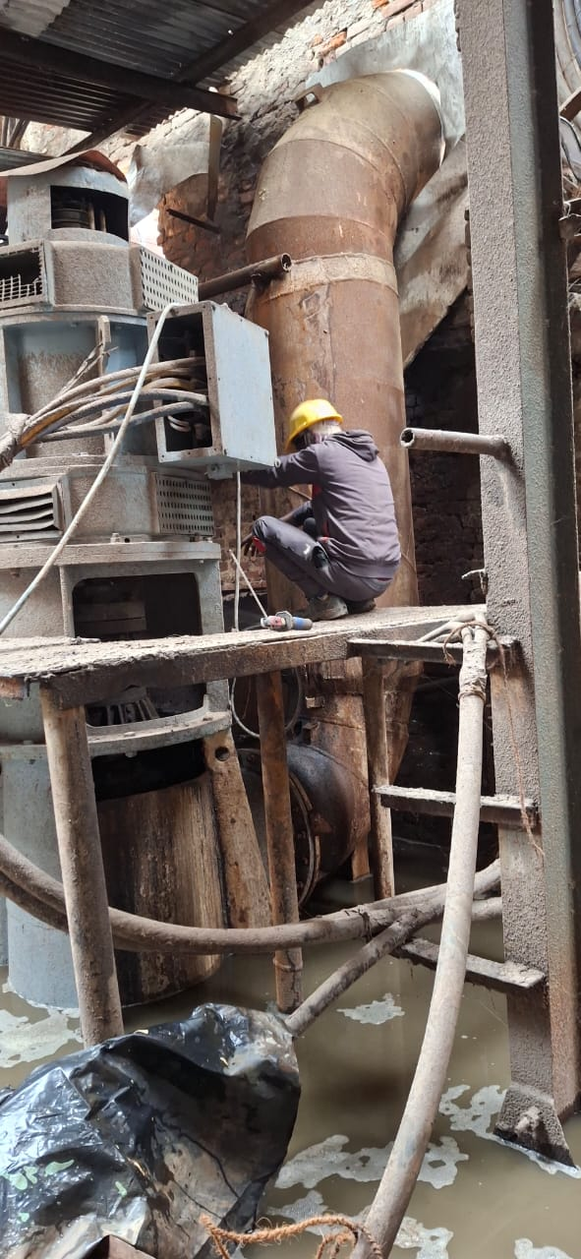
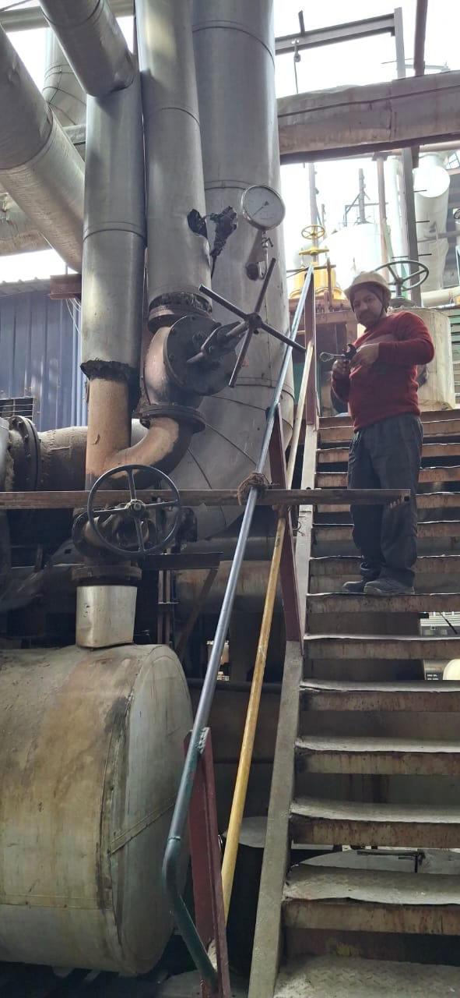
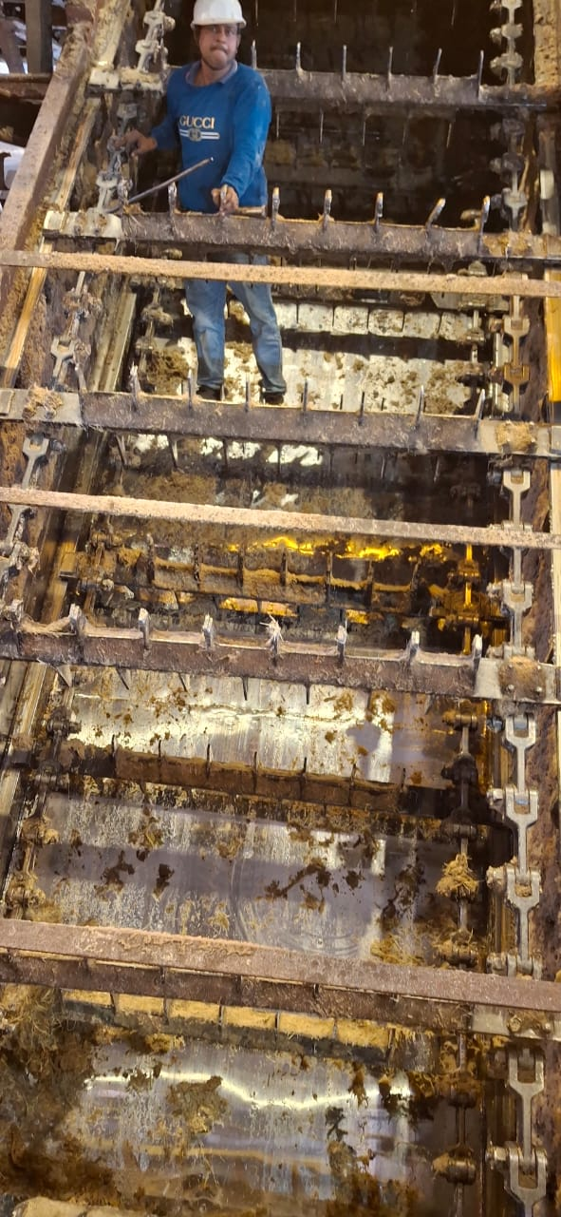
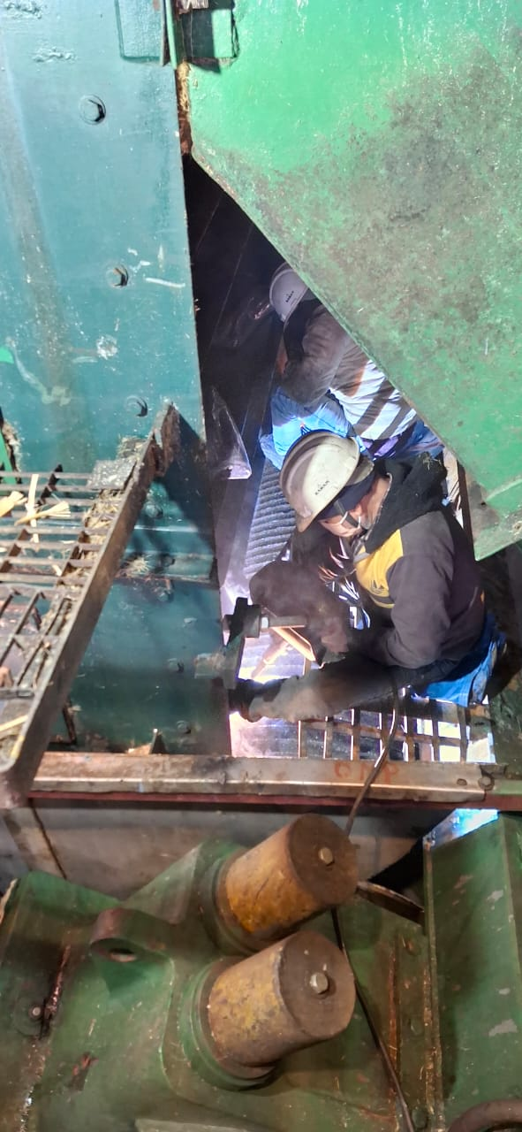
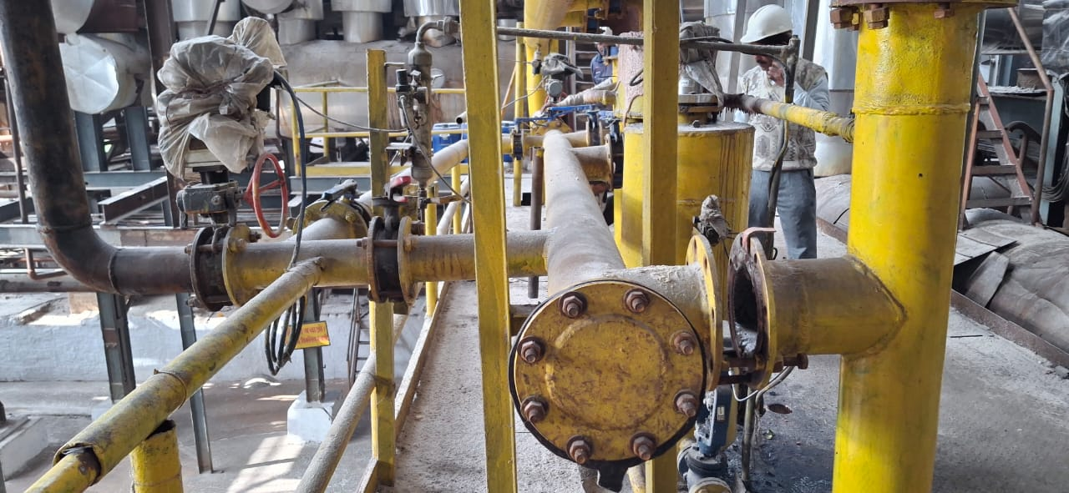
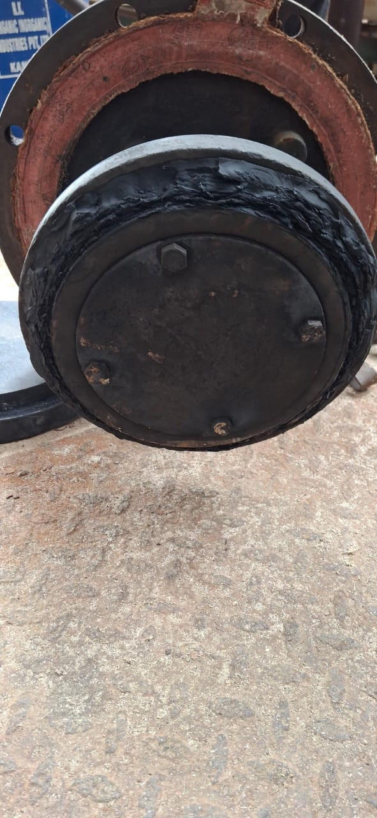
General Cleaning Major Jobs

Slide 59
General Cleaning Major Jobs
3rd GENERAL CLEANING MILL HOUSE on Date 03.01.2026 Time - 4-5 Hrs
Sl.No | Work Description | Responsibity | Material Reqd | Mat status | Aprox time | Engineer
1 | A.To be change of Domite tips of Shredder. B.To be replacement of wornout side hammers - 8 No C.To be checking /replacement of coupling pins towards cane yard side & both checking too... D- To be rib welding of snub pulley. | Shivpal,Jonu,Mukesh(CUO),Sunil vishwakarma,Suresh CUO,Ramchandra Shukla, Upender Khalasi,Balakram,&Hari Singh 3 nos labour. | Domite Tips/Torq Wrench | Available | 4-5 hrs | Devesh Kumar
 | E.To be increase opening of belt equalizer by 16 MM | Tharayil Contractor/ Dhananjay Rai | Packing | Available | 3 hrs | do
2 | A.Slat cleaning brush drive chain to be replacement. B. To be belt skirting replacement. | Satender,Sanjay,Jamuna |  |  | 2-3 Hrs | do
 | C.Both side angle guide to be check under Shredder. | Shivpal, Jonu,Thrayil Contractor. | ISA | Available | 2-3Hr | do
3 | a.Routine checking of Shredder Elevator & all IRC. B.To be replacement of one bend rke of IRC 2. C.To be checking /replacement of head & tail sprockets scrapper. | Chottey,Ramparvesh,Sher Singh Welder | tooltackles etc | Available | 3 hrs | Faizan
 | A.To be straight of bend spokes of IRC 1. | Tharayil Contractor/ Dhananjay Rai
4 | A.Checking & gland packing filling of all pumps & valves throughly.(Sply Hot Water Pump & Valve) | Karamchand,Premkant(Pump Attd) |  | Available | 3hrs
5 | To be checking of Mill No 2 T.Gear out put brg. B. Gen.Checking of all Mill transmission gear. | Gurmeet,Mohit, Sunil Pd for EOT | Grinder etc | Available | 3 hrs | Dinesh Kushwah
6 | A.To be check /replacement top roller scrapper of Mill No 1. B.Routine checking of Mill 0,1,2 ,TUFR Scrapers gap of Mill,trash plate,scrapper end teeth cutting,& meschart knives incl transmission gearing bolt and Specially All Nose Plate gap. C.To be throughly checking & fitting of 2 bolts of TUFR Roller bearin block & checking of TUFR scraper gap of Mill no 2. D.To be tightning of RLD scrapper of zero mill. | Nekram, Ramashish,Manoj welder,Dhanajay Rai foreman,Rajkumar, Balister,Rampal. | Hard facing & ss electrode,meschart knives. | Available | 4-5 Hrs
 | E.To be checking Nose plate gap of Mill 1&2.(First priority) | do | do | do |  | do
7 | Arcking of Zero & 4th Mill top roller on priority. | Ramkishore, Ankur & Vijay , Deena | Azucar 80 | Available | 4-5 hrs | do
8 | a. All Mill Rope Coupling /Meshchart checking work | Udesh sharma,Tejpratap, Dhanjay formen | BOLT & NUT M24,20 | Available | 3 Hrs | Dinesh Kushwah
9 | a.Routine checking of 3rd & 4th as 3rd TUFR Scraper,Trash plate,scrapper side teeth cutting & Nose Plate etc . B.To be tightning of RLD Scraper of 4th Mill. | Gajendra, Papu, Manoj Welder | Electrodes 6006 | Available | 3-4Hrs | Dinesh Kushwah
 | c.To be checking Nose plate gap of Mill No 3(First priority) | do | do | do | 3-4 Hrs
10 | Kicker knives checking,MCC & ACC chain tightning as reqd etc. | Dharamdev,Dharmendra,Rajkumar pandey,Ramnaresh murli | HT Bolt with nylock nut 24x110 | Available | 2-3 hrs | Ravi saxsena
11 | All Mill bearings checking specially M1F,2D&M3F incl leaking. B.To be greasing of input T.Gear brg and couplings. | Jagdish (oilman) ,Anil (CUO),hari singh labour no.1 |  | Available | 3-4 hrs | Dinesh kushwah
12 | A.Rotary screen Washing by Caustik firstly Primery and than both Secondary. B.To be cleaned nozzles of water washing header of all rotary screen. | Suresh Sharma,Baburam Sajjan & Hari Singh Contractor manpower | Caustik | Available | 2-3 hrs | Raviraj Saxsena
13 | A.All Juice tanks dummy to be open/boxup after washing. B.To be flushing of both imbibition header. | Santosh Fitter,Kurendra |  | Available | 3 hrs
14 | MCC slate Wear pad welding work,(to be attend on priority) | Shaban,Shersingh,Chandra Prakash(W/S),B/H Cont'sWelder | Two Welding Machines(Tharayil),1 Cane Dept,1 W/s & Wear Pads | Available | 4 hrs

Slide 60
General Cleaning Major Jobs
 | D.S house Job to be done during shut down on 3/01/26
S.No. | Detail of Jobs
1 | Juice side and syp- side SO2 gas header cleaning to be done
2 | Leaky syrup line of set A & B at syrup sulphiter to be replaced
3 | Leaky D/V of set B VLJH to be welded .
4 | Leaky main valve (1st vapour) of pan washing to be repaired.
5 | 2nd vapour condensate syphon is leaky near cigar to be welded.
6 | Clear juice line leaky at dorr to be replaced.
7 | Mud over flow box bottom is weak its outlet line nipple 8" and 10" also weak to be replaced
8 | Magnet of syrup line to be cleaned.
9 | At evaporator set all butter fly valve of syrup header to be checked/repaired, maximum valve are leak
10 | Leaky condensate line (2nd vapour) near conti-machine no-11 to be replaced

Slide 61
General Cleaning Major Jobs
Raw and Refinery House shut down job list as on dated 03.01.26
Sr.No. | Jobs to be done |  | Job Related to
1 | S.K -3400 m2 body , juice inlet & outlet valve gland to be provided. |  | Mechanical
2 | Socket of temp. gauge of Condensate Juice heater No.3 , to be checked and welded. |  | Mechanical
3 | Mud pump north side leaky reducer to be replaced with new. |  | Mechanical
4 | 6" butterfly valve of cool condensate line to overhead cold water tank to be replaced. |  | Mechanical
5 | Hot water tank ( C mono vertical crystalizer ) damage top plate to be replaced. |  | Mechanical
6 | 2nd vapour header air vent valve joint replaced below Raw Pan No.1 |  | Mechanical
7 | Raw Pan No.5 cut over valve to be checked. |  | Mechanical
8 | Raw sugar minglar and melter in side arms to be checked. |  | Mechanical
9 | Raw melt buffer tank SS wire netting to be replaced. |  | Mechanical
10 | IER column No.2 , melt & hot water inlet flow heavy fluctuation due to auto control valve.To be checked and rectified. |  | Instrument
11 | Refinery sugar hopper No.1 , SS wire netting frame torn out to be replaced. |  | Mechanical
12 | Both sugar graders all SS wire netting to be checked. |  | Mechanical
13 | Proof stick of new R3 pan to be set right. |  | Mechanical
14 | Raw melter steam line header leaky butterfly valve joint to be replaced. |  | Mechanical
15 | MOL Hydrocyclone to be newly replaced. |  | Mechanical
16 | New R3 pugmill leaky gland packing to be newly replaced. |  | Mechanical
17 | Scum line from low bx. Sweet water tank to juice Sulphiter is leak at 2-3 points,to be replaced with new. |  | Mechanical
18 | Leaky bagacillo line to be binded by rubber or PP bag liner with coconut rope. |  | Mechanical
19 | Centrifugal station Exhaust steam line 50 mm valve leaky gland to be newly provided. |  | Mechanical
20 | Lime sucrate holding tank inside cleaning to be done. |  | Production
21 | Inside cleaning of Deficator. |  | Production
22 | Cleaning of SRT Lounders |  | Production
23 | In side cleaning of Flotation clarifier coils at MCS & SCS. |  | Production
24 | Tube cleaning of Raw Pan No. 2 |  | Production
25 | L& S Sugar Bin inside cleaning. |  | Production

Slide 62
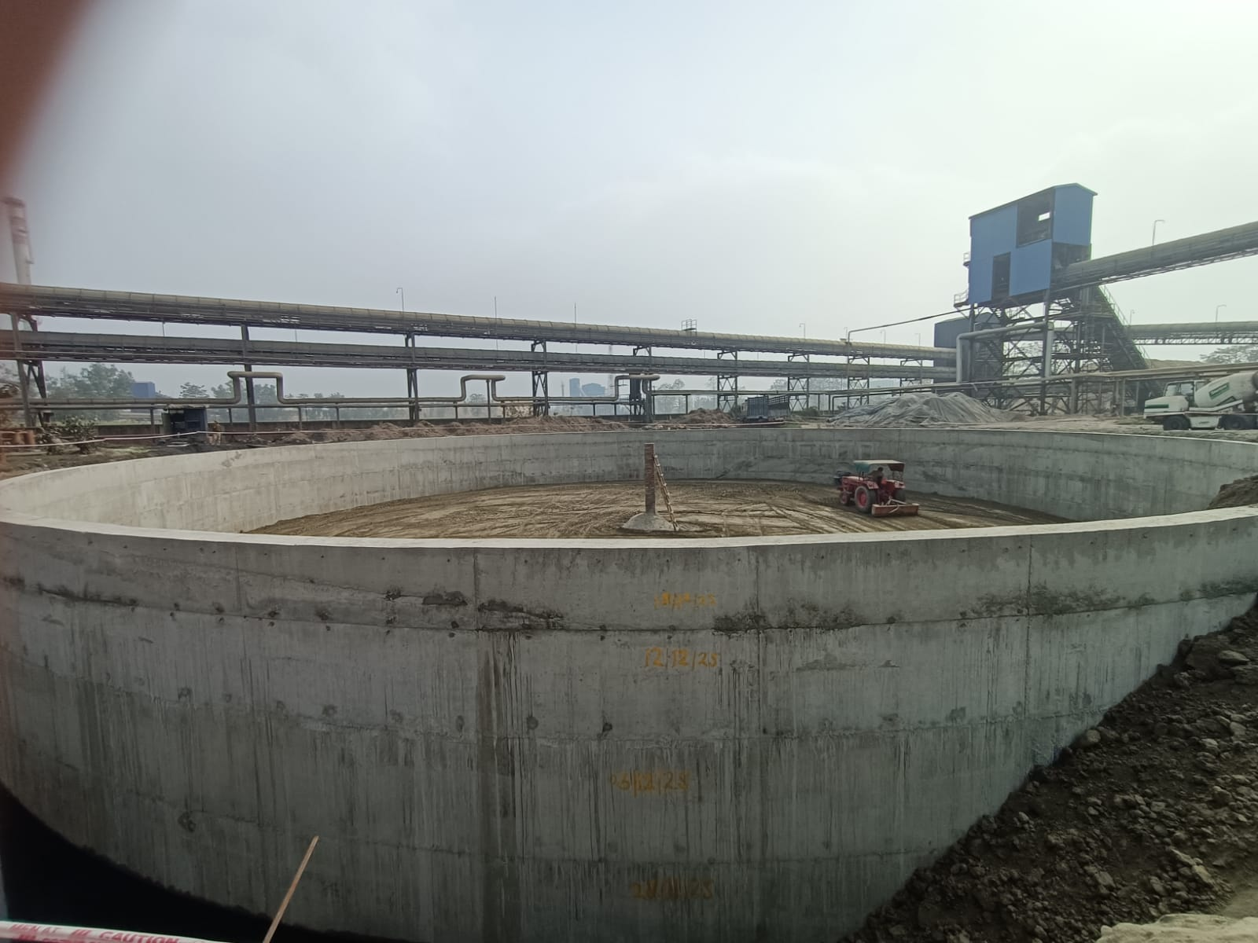
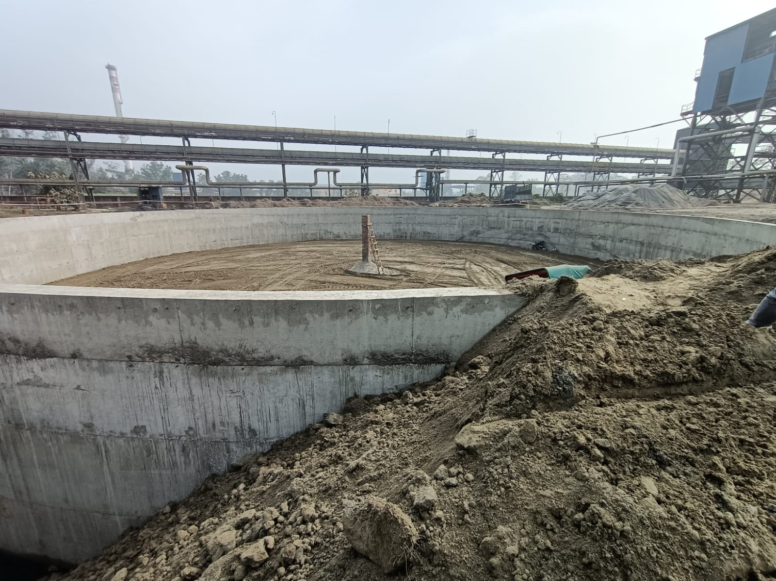
Outer Ring wall casting done & inside Send filling & Compaction work Under progress
Capex Under Progress
New Molasses Tank Foundation

Slide 63
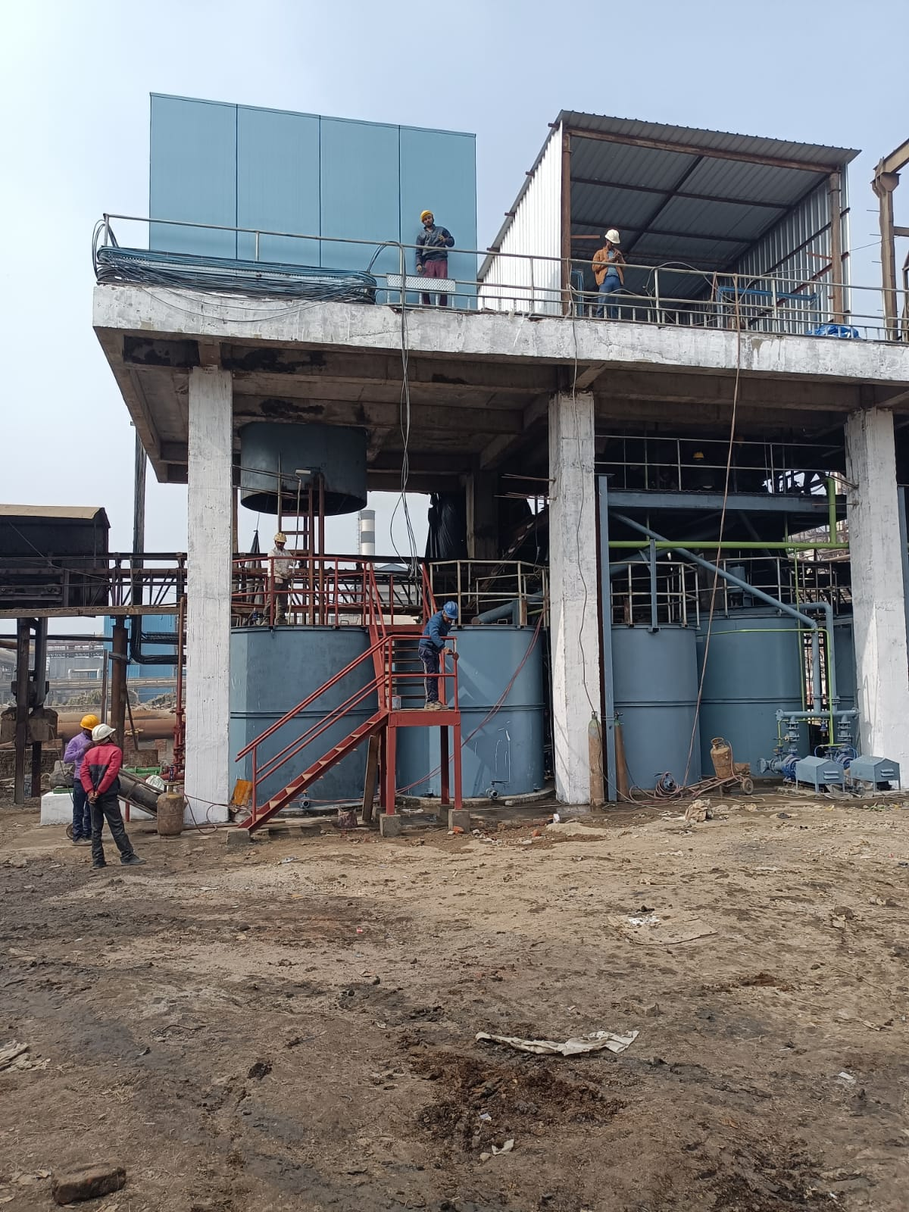
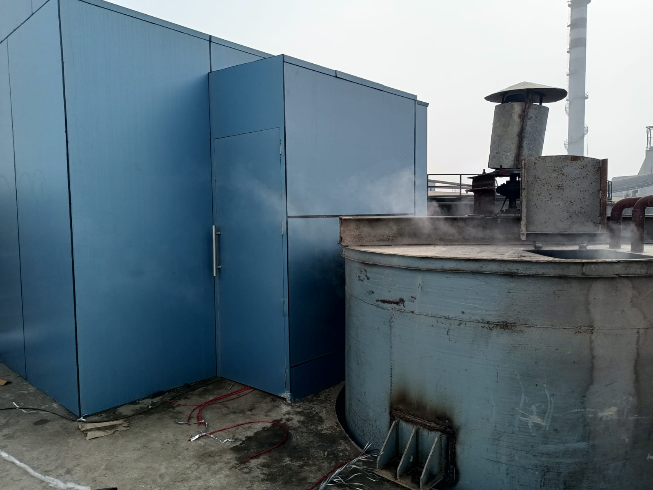
Mud Removal System –Decanter
Both Decanter, Tanks with piping Erection completed.
Panel Placed at position electrical & Instrument wire work under progress.
GEA & Chemical system may be reached at site by 05.01.2026 to start commissioning

Slide 64
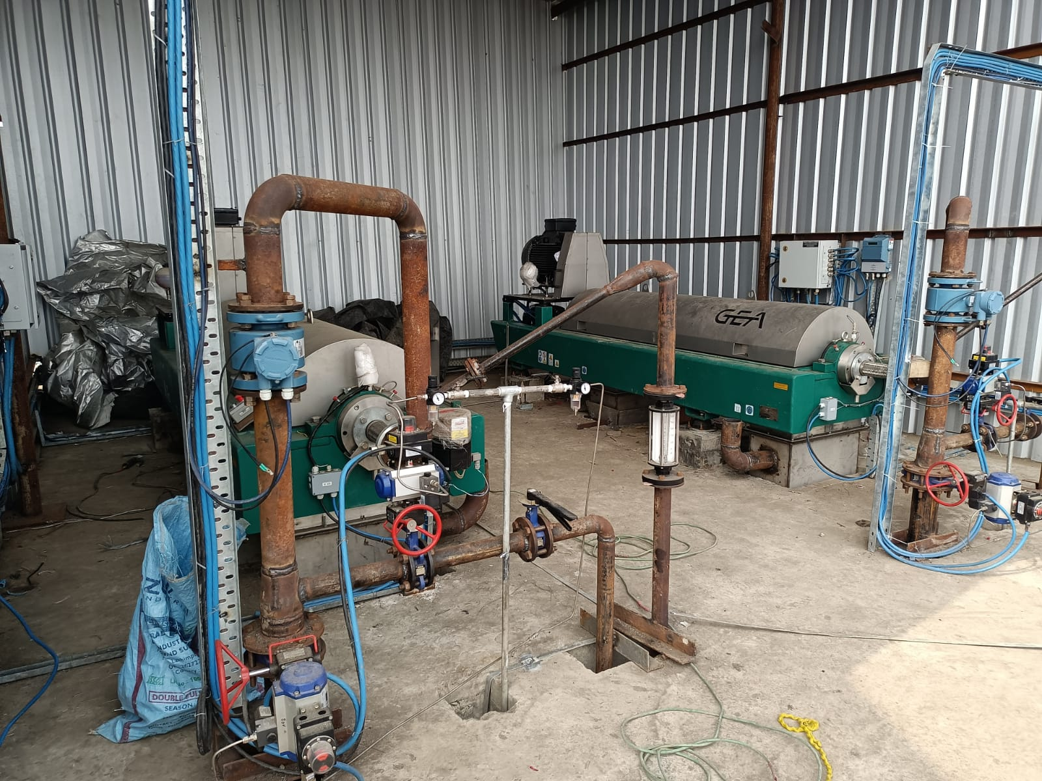
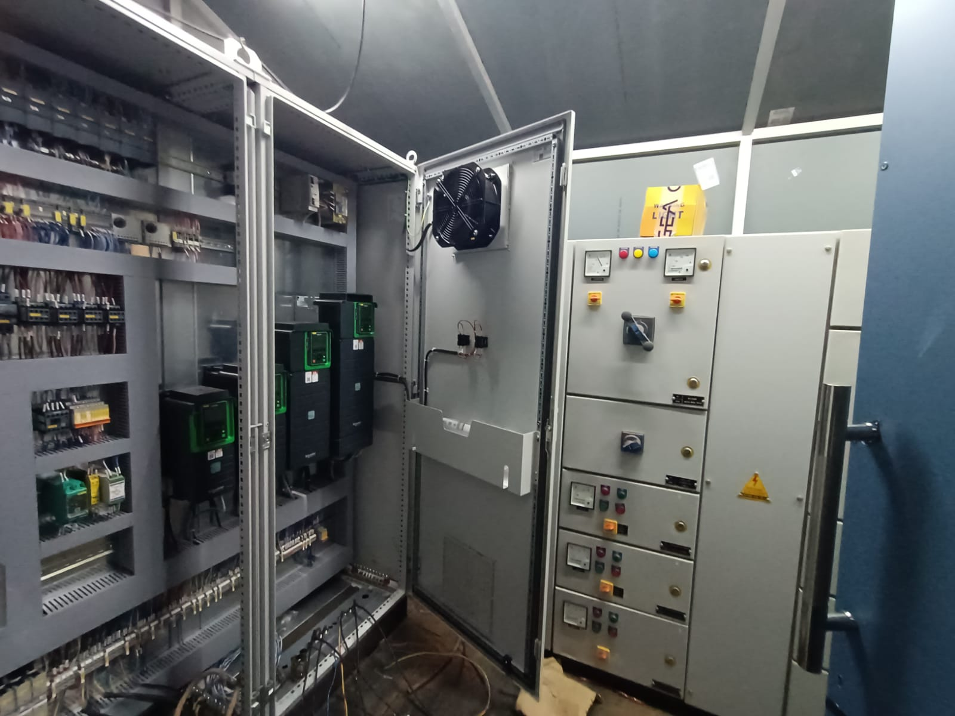
Mud Removal System –Decanter
Decanter all connection Completed .
Electrical & Instrument Cabling work Completed.

Slide 65
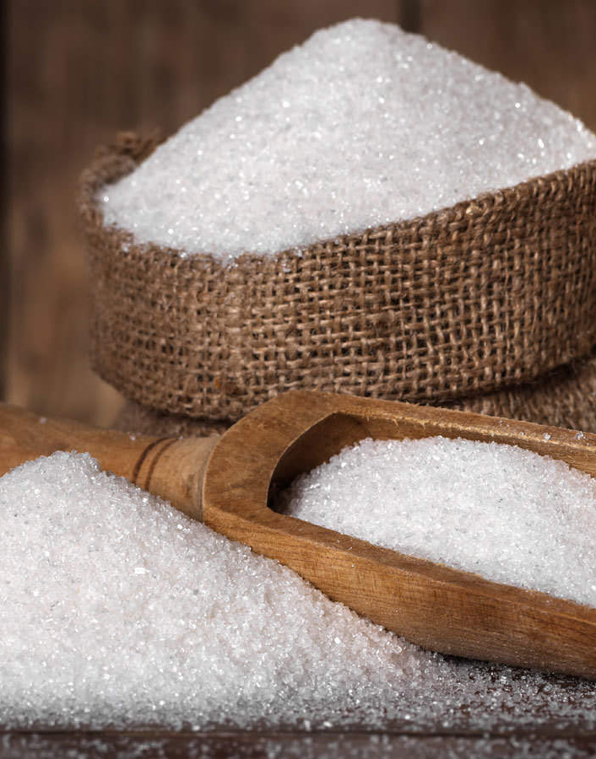
PRODUCTION

Slide 66
General Observation
The M/s GEA representative is awaited for commissioning of the Mud Removal System.
All mechanical work for the Mud Removal System has been completed. Electrical and instrumentation cable laying, along with all electrical and instrument connections, has also been completed. Trial runs of seven drives have been successfully carried out. The decanter trial will be conducted in the presence of the GEA representative.
The R3 massecuite boiling system has been taken into operation and is running satisfactorily in all respects.
B-Heavy molasses diversion has been started in the refinery house w.e.f. 04/01/2026.

Slide 67
MRS Project – Work Progress and Delay Analysis
Target Completion date - 30th October 2025
Estimated Project Completion date – 10th January 2026
SN | Work Description |  | PO date | Completion/Material Received date as per PO | Actual Date Of start | Actual Date Of start | Actual Completion/Material Recieved date | Total days Delay in work
1 | Civil | Foundation | 05/08/2025 | 05/10/2025 | 01/08/2025 | 5th August 2025 | 16/12/2025 | 71 days ( Delayed Due to rain , Scaffolding size change due to change in elevation and less manpower availability of civil contractor)
 |  | Column
 |  | Slab
2 | MRS material | Decanter | 19/06/2025 | 25/08/2025 |  |  | Last consignment received on 07/09/2025 | 12 days
 |  | Pumps with Motor
 |  | Electrical and Instrument accessories
3 | Erection of tanks and pumps | Equipment Shifting | 10/10/2025 | 30/10/2025 | 17/12/2025 | 17th Dec 2025 | Under Progress | All Mechanical, electrical and instrument related work completed .
 |  | Pumps and valve Installation
 | Erection and commissioning | Decanter Levelling | 10/10/2025 | 30/10/2025
 |  | Panel installation
 |  | Instrument and Electrical connection

Slide 68
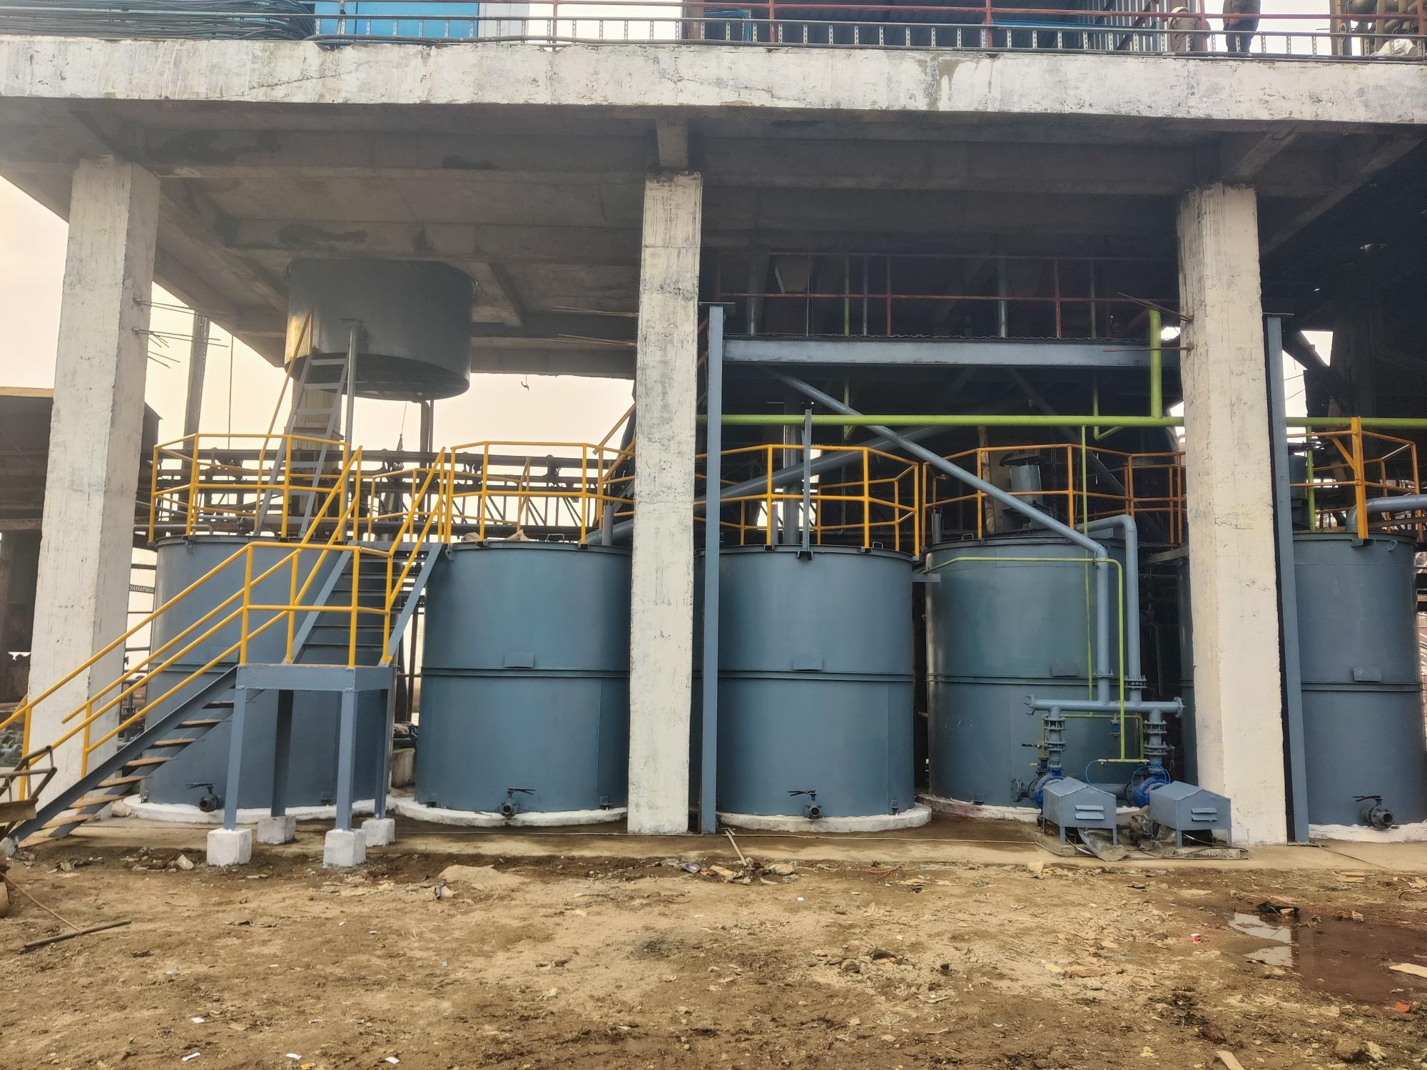
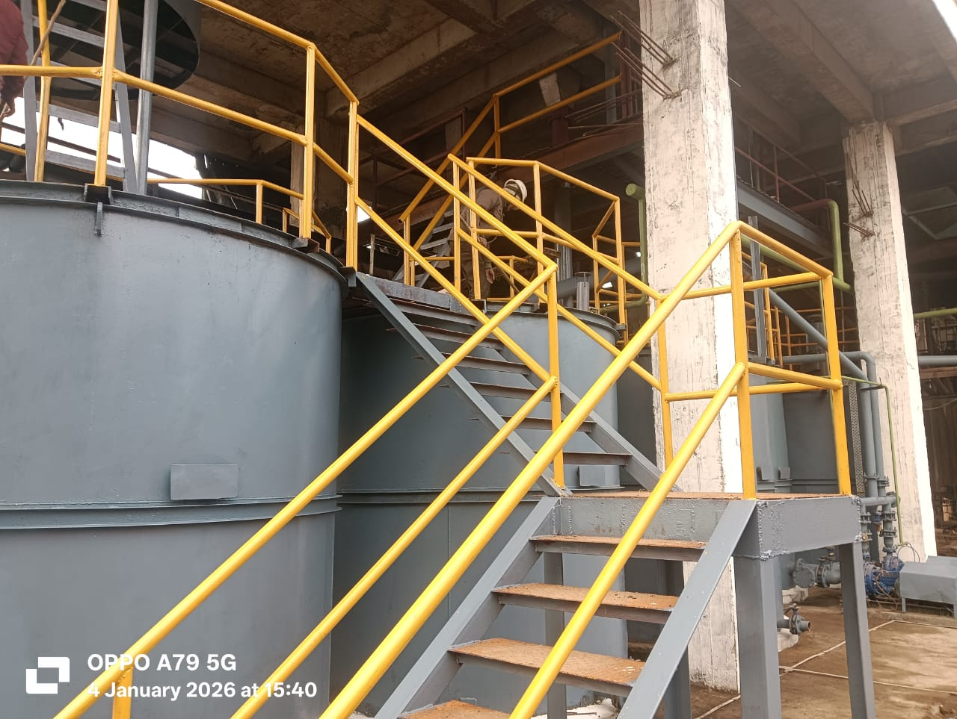
MRS Project-Tanks

Slide 69
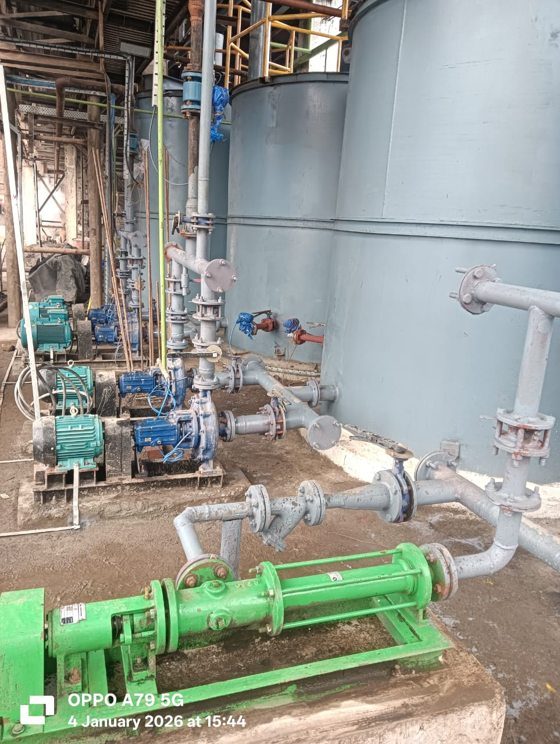
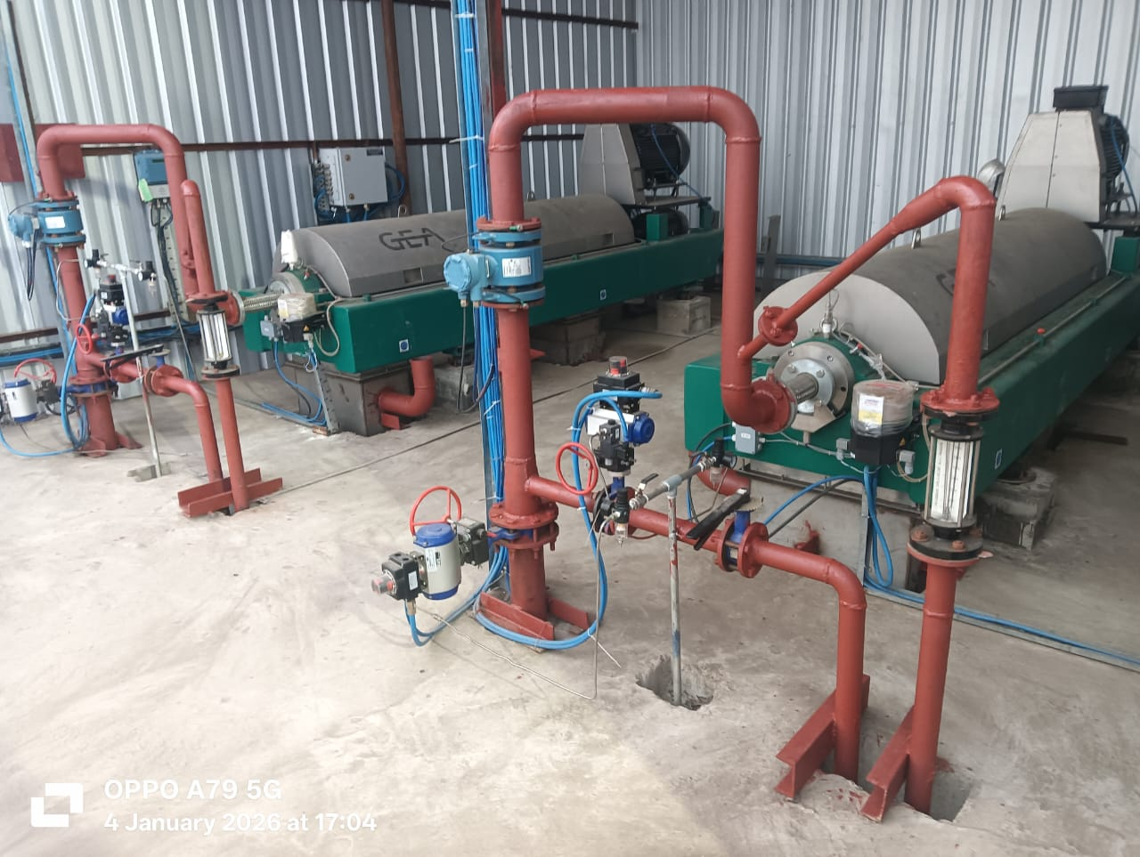
MRS Project-Pumps & Decanter

Slide 70
Weekly Performance Snapshot - Production
No. | Capacity Utilization | Target | Current Week | Last Week | Till Date
1 | Sugar Production (LQ) | 15.26 | 0.61 | 0.65 | 5.75
2 | Sugar Bagging – RS (Qtl) | 824250 | 37103 | 39033 | 353366
3 | Sugar Bagging – DS (Qtl) | 702139 | 23937 | 26264 | 221446
 | Recovery
4 | Sugar Recovery CH – RS (%) | 10.14 | 11.18 | 11.19 | 10.19
5 | Sugar Recovery CH – DS (%) | 10.14
6 | Sugar Recovery BH – RS (%) | 10.69
7 | Sugar Recovery BH – DS (%) | 10.69 | 9.45 | 9.44 | 9.56
8 | C-Mol Recovery – RS (%) | 4.80 | 4.16 | 3.90 | 4.11
9 | B-Mol Recovery – DS (%) | 7.20 | 6.40 | 7.18 | 6.96
 | Quality
10 | C-Mol Purity – RS | < 33.00 | 32.53 | 32.29 | 32.53
11 | B-Mol Purity – DS | < 51.00 | 50.20 | 50.66 | 50.57
12 | Losses in Mol % Cane CH – RS | < 1.39 | 1.24 | 1.15 | 1.91
13 | Losses in Mol % Cane BH – DS | < 3.18 | 2.96 | 2.88 | 2.85
14 | Pol % Filter cake | < 2.00 | 2.00 | 1.90 | 2.00
 | Consumption
15 | Steam Consumption (Kg/Qtl Sugar) | 400 | 459 | 454 | 487
16 | Steam % Cane | <42 | 40.47 | 39.49 | 39.98
17 | Power Consumption (Units/Qtl Sugar) | 11 | 12.54 | 11.62 | 12.43
70

Slide 71
Weekly Sugar Production – DS House
Production Plan for Next Week
SKU | Quantity (Qtls) | % of Total
L | 0 | 0
M | 22661 | 90
S | 2518 | 10
Total | 25179 | 100

Slide 72
Weekly Sugar Production – RS House
Production Plan for Next Week
SKU | Quantity (Qtls) | % of Total
L | 4016 | 10
M | 28113 | 70
S | 6024 | 15
Pharma | 2008 | 5
Total | 40161 | 100
Icing | 5 | 0.29
Bura | 100 | 5.97
Sachet | 90 | 5.37
1kg pack | 500 | 29.85
5kg pack | 300 | 17.91
Superfine | 80 | 4.76
Brown 1kg | 100 | 5.97
Pharma | 500 | 29.85
Total | 1675 | 100%

Slide 73
Sugar Production Quality
Sugar Quality | Season 2025-26 |  |  |  | Season 2024-25
 | Target | Current Week | Last Week | Till Date | Week | Till Date
Sugar Quality - DS
ICUMSA (L-sugar) | <110
ICUMSA (M-sugar) |  | 85 | 92 | 105 | 102 | 120
ICUMSA (S-sugar) |  | 88 | 98 | 106 | 100 | 120
Sugar Quality – RS
ICUMSA (L-sugar) | <30 | 32 | 29 | 33 | 36 | 35
ICUMSA (M-sugar) |  | 32 | 29 | 33 | 35 | 35
ICUMSA (S-sugar) |  | 33 | 31 | 35 | 36 | 37
Sugar Quality Pharma
ICUMSA (SS - Sugar) | <25 | 30 | 30 | 32
ICUMSA (20/80 - Sugar) |  | 30 | 28 | 31 | 29 | 30
ICUMSA (30/80 - Sugar) |  | 31 | 26 | 31 | 32 | 33

Slide 74
Monthly Performance Snapshot - Production
S.No. | Capacity Utilization | Target | Dec.-25 | Dec.-24 | Nov.-25 | Nov.-24
1 | Sugar Production (LQ) | 15.26 | 2.89 | 2.77 | 2.62 | 2.12
2 | Sugar Bagging – RS (Qtl) | 824250 | 173434 | 169441 | 166302 | 120188
3 | Sugar Bagging – DS (Qtl) | 702139 | 115599 | 108046 | 95920 | 91961
 | Recovery
4 | Sugar Recovery CH – RS (%) | 10.14 | 11.03 | 10.75 | 9.39 | 9.28
5 | Sugar Recovery CH– DS (%) | 10.14 | 10.63(01 Dec. to 08 Dec.) | 10.45(01 Dec. to 21 Dec.) | 9.40 | 9.13
 | Sugar Recovery BH – RS (%) | 10.69
 | Sugar Recovery BH– DS (%) | 10.69 | 9.43(9 Dec. to 31 Dec.) | 9.45(22 Dec. to 31 Dec.)
6 | C-Mol Recovery – RS (%) | 4.8 | 4.34 | 4.77 | 4.41 | 4.65
7 | C-Mol Recovery – DS (%) | 5.2 | 5.12(01 Dec. to 08 Dec.) | 4.98(01 Dec. to 21 Dec.) | 3.86 | 4.62
8 | B-Mol Recovery – RS (%) | 6.8
9 | B-Mol Recovery – DS (%) | 7.2 | 6.96(9 Dec. to 31 Dec.) | 7.45(22 Dec. to 31 Dec.)
 | Quality
10 | C-Mol Purity – RS | <33.00 | 32.08 | 30.80 | 31.21 | 32.23
11 | C-Mol Purity – DS | <32.00 | 30.31(01 Dec. to 08 Dec.) | 30.68(01 Dec. to 21 Dec.) | 30.07 | 31.86
12 | B-Mol Purity – RS | <51.00
13 | B-Mol Purity – DS | <51.00 | 50.52(09 Dec. to 31 Dec.) | 51.10(22 Dec. to 31 Dec.)
14 | Losses in Mol % Cane CH– RS | <1.39 | 1.15 | 1.30 | 1.20 | 1.40
15 | Losses in Mol % Cane CH – DS | <1.46 | 1.18(01 Dec. to 08 Dec.) | 1.30(01 Dec. to 21 Dec.) | 1.23 | 1.41
16 | Losses in Mol % Cane BH – RS | <3.00
17 | Losses in Mol % Cane BH – DS | <3.18 | 2.86(09 Dec. to 31 Dec.) | 3.23(22 Dec. to 31 Dec.)
18 | Pol % Filter Cake | <2.00 | 1.95 | 1.96 | 2.05 | 1.95
 | Consumption
19 | Steam Consumption (Kg/Qtl Sugar) | 400 | 449 | 457.50 | 532 | 580
20 | Steam % Cane | 42 | 39.89 | 41.35 | 40.09 | 40.83
21 | Power Consumption (Units/Qtl Sugar) | 11 | 11.85 | 12.05 | 13.03 | 12.91

Slide 75
Steam consumption target Vs actual at different process
At Recovery % | Process option - 1 |  |  | Process option - 2 |  |  | Process option - 3
 | RS & DS on C-heavy with 125 KLD Distillery on Syrup |  |  | Both process on B-heavy with 125 KLD Distillery on Syrup |  |  | Both process on B-heavy
 | Target | Week actual | Actual till date | Target | Week actual | Till date | Target | Week actual | Actual Till date
10.50 | 42.00 | 40.47 | 39.98 | 40.07 |  |  | 41.00

Slide 76

POWER PLANT

Slide 77
HIGHLIGHTS FOR THE WEEK
On 13th December 2025, plant achieved its highest-ever generation, reaching 946.56 MW, which is 98.6% of the installed capacity. 30.85 MW Power Plant The 30.85 MW Co-generation Plant is operating satisfactorily. All parameters of the 150 TPH Boiler and 30.85 MW Turbine were observed to be within normal limits during full-load operation. Avg. Steam Flow :148.2 TPH & Avg. TG load 28.82 MW. 70 TPH Boiler The 70 TPH boiler performed satisfactorily. Avg. Steam Flow :67.2 TPH. 4.0 MW Distillery Power Plant The 4.0 MW Distillery Co-generation Plant operated satisfactorily during the period, except for a planned shutdown on 03.01.2026. During the shutdown, steam was supplied from the 70 TPH boiler to ensure uninterrupted distillery operations. Avg steam load 32.30 TPH and Avg power load 3.80 MW with the slop consumption of 2.70 TPH.

Slide 78
Weekly Performance Snapshot - Power
S.N | Generation & Export | Current Week | Last Week | Till Date
1 | Total Power Generation (LU) | 63.66 | 64.71 | 636.12
2 | Power Export (LU) | 36.80 | 36.92 | 375.73
3 | Power Export (%) | 57.81 | 57.05 | 59.07
 | Power Consumption (% of Gen.) | 42.19 | 42.95 | 40.93
4 | Sugar Plant Process (% of Gen. ) | 30.06 | 30.90 | 28.57
5 | Distillery Plant Process (% of Gen. ) | 4.05 | 4.04 | 3.95
6 | Aux Consumption (% of Gen.) | 8.09 | 8.01 | 8.41
78

Slide 79
Weekly Performance Snapshot – Power
 | Boiler Capacity Utilization | Target | Current Week | Last Week | Till Date (25-26) | Till Date (24-25)
1 | Capacity Utilization - 150 TPH | >144.0 | 148.2 | 151.2 | 150.4 | 141.9
2 | Capacity Utilization – 70 TPH | >64.0 | 67.2 | 69.7 | 67.4 | 65.0
3 | Capacity Utilization – 35 TPH | >33.0 | 32.3 | 33.1 | 32.7 | 31.9
 | Turbine Capacity Utilization
4 | PLF % – 30.85 MW | > 95.00 | 96.07 | 96.69 | 97.05 | 92.07
5 | PLF % – 3.0 MW (O) | > 90.00 | 90.10 | 94.60 | 93.65 | 91.81
6 | PLF % – 3.0 MW (N) | > 75.00 | 85.53 | 90.34 | 86.41 | 79.58
7 | PLF % – 4.0 MW | > 90.00 | 95.06 | 99.14 | 95.85 | 88.24
 | Efficiency
8 | Steam/Fuel Ratio – 150 TPH | ≥2.54 | 2.56 | 2.56 | 2.55 | 2.52
9 | Steam/Fuel Ratio – 70 TPH | ≥2.19 | 2.21 | 2.22 | 2.20 | 2.16
10 | Steam/Fuel Ratio – 35 TPH | ≥1.88 | 2.16 | 2.16 | 2.17 | 2.05
11 | Specific Steam – 30.85 MW | <5.20 | 5.14 | 5.20 | 5.14 | 5.11
12 | Specific Steam – 3 MW (O) | <9.00 | 8.70 | 8.62 | 8.51 | 8.63
13 | Specific Steam – 3 MW (N) | <9.00 | 8.88 | 8.81 | 8.76 | 8.93
14 | Specific Steam – 4 MW | <9.20 | 8.45 | 8.34 | 8.58 | 8.99
79

Slide 80
Key Operational Parameters: Overall SPE Division
Plant Availability
Sr. No. | Description | Current Week | Last Week |  | Till Date SS 25 - 26 | Till Date SS 24 - 25
 |  | 28/12/2025 to 03/01/2026 | 21/12/2025 to 27/12/2025 |  | 26/10/2025 to 03/01/2026 | 26/10/2024 to 03/01/2025
1. | 150 TPH Boiler | 100% | 100% |  | 99.98% | 97.46%
2. | 70 TPH Boiler | 100% | 100% |  | 99.66% | 99.21%
3. | 35 TPH Boiler | 97.62% | 100% |  | 99.00% | 97.86%
4. | 30.85 MW Turbine | 100% | 100% |  | 99.86% | 96.82%
5. | 4 MW Turbine | 97.39% | 100% |  | 98.65% | 97.17%
6. | 3 MW_Old Turbine | 98.35% | 100% |  | 99.29% | 98.63%
7. | 3 MW_New Turbine | 96.94% | 100% |  | 97.32% | 95.07%
8. | 132 KV GRID | 99.90% | 99.65% |  | 99.87% | 99.73%

Slide 81
Key Operational Parameters: Overall Power Generation , Export and Consumption of SPE Division
Sr. No. | Particulars | UOM | Target | Current Week |  | Last Week |  | Till date SS 25-26 |  | Till date SS 24-25
 | Operation | Days | Avg. | 7 | Avg. | 7 | Avg. | 70 | Avg. | 69 | Avg.
1. | 30.85 MW STG | MWH | 28.50 | 4842.00 | 28.82 | 4873.00 | 29.01 | 48915.00 | 29.12 | 45738.00 | 27.62
2. | 3 MW _Old STG | MWH | 2.70 | 454.10 | 2.70 | 476.77 | 2.84 | 4517.55 | 2.81 | 4560.93 | 2.75
3. | 3 MW _ New STG | MWH | 2.25 | 431.08 | 2.57 | 455.29 | 2.71 | 4106.41 | 2.59 | 3781.77 | 2.28
4. | 4.0 MW STG | MWH | 3.60 | 638.80 | 3.80 | 666.20 | 3.97 | 5590.80 | 3.83 | 6072.80 | 3.67
5. | Power Exported | MWH | 22.00 | 3680.00 | 21.90 | 3692.00 | 21.98 | 37573.00 | 22.36 | 35453.00 | 21.41
6. | Sugar Plant Consumption | MWH | 10.44 | 1910.18 | 11.37 | 1996.06 | 11.88 | 18473.69 | 11.00 | 16674.70 | 10.07
7. | Distillery Plant Consumation | MWH | 1.60 | 257.52 | 1.53 | 261.64 | 1.56 | 2510.25 | 1.58 | 2486.77 | 1.57
8. | 30 MW Cogen Aux. Cons. | MWH | 2.70 | 401.80 | 2.39 | 404.17 | 2.41 | 4077.47 | 2.43 | 4079.79 | 2.46
9. | 4.0 MW Cogen Aux. Cons. | MWH | 0.80 | 99.08 | 0.59 | 99.76 | 0.59 | 957.75 | 0.60 | 954.03 | 0.60

Slide 82
Key Operational Parameters: Overall Power Generation , Export and Consumption of SPE Division
Sr. No. | Particulars | UOM | Target | Current Week | Last Week | Till date SS 25-26 | Till date SS 24-25
 | Operation | Days | Avg. | 7 | 7 | 70 | 69
1. | Capacity Utilization – 30.85 MW STG Set | % | > 95.00 | 96.07 | 96.69 | 97.05 | 92.07
2. | Capacity Utilization – 3.0 MW _ Old STG Set | % | > 90.00 | 90.10 | 94.60 | 91.81 | 93.65
3. | Capacity Utilization – 3.0 MW _ New STG Set | % | > 75.00 | 85.53 | 90.34 | 79.58 | 86.41
4. | Capacity Utilization – 4.0 MW STG Set | % | > 90.00 | 95.06 | 99.14 | 95.85 | 88.24
5. | Aux. Consumption of 30.85 MW | % | < 9.20 | 8.30 | 8.29 | 8.34 | 8.92
6. | Aux. Consumption of 4 MW | % | < 20.00 | 15.30 | 14.97 | 15.67 | 17.06
7. | Power Consumption Per Ton of Cane Crushed | KWH/Ton on Cane | < 31.54 | 32.96 | 31.96 | 32.14 | 32.76

Slide 83
KEY OPERATIONAL PARAMETERS 30.85 MW PP (150 TPH BOILER)
Parameters | UOM | DATE
 |  | 28-Dec | 29-Dec | 30-Dec | 31-Dec | 01-Jan | 02-Jan | 03-Jan
Cane Crushed | QTL | 100000 | 106000 | 108000 | 100000 | 106500 | 101500 | 69500
Steam Gen. | MT/ HR | 149.7 | 151.3 | 151.2 | 150.1 | 151.2 | 150.6 | 133.6
Power Gen. | MWH | 28.75 | 29.17 | 29.21 | 29.08 | 29.38 | 29.50 | 26.67
Bag. Moisture | % | 51.3 | 50.2 | 50.4 | 49.8 | 50.2 | 50.1 | 50.3
GCV : Bagasse | KCal/ Kg | 2220 | 2270 | 2261 | 2289 | 2270 | 2275 | 2266
Gross SHR of PP (Kcal/Kwh) | 25-26 | 2811 | 2741 | 2718 | 2718 | 2756 | 2768 | 3002
 | 24-25 | 2777 | 2718 | 2648 | 2833 | 2762 | 2757 | 3006
Gross Boiler Eff.(71.95as per PG test) | % | 69.88 | 70.88 | 70.77 | 71.35 | 70.99 | 71.08 | 70.63

Slide 84
BAGASSE GENERATION & CONSUMPTION DETAILS
Particulars | UOM
Operation days | NOS.
Cane Crushed | MT
Bagasse Received | MT
Bagasse Stock | MT
Steam% Cane | %
Hourly | Current Week | Last Week | Hourly (Till Date)
Target | SS 25-26 | SS 25-26 | SS 25-26 | SS 24-25
 | 7 | 7 | 70 | 69
416.7 | 411.6 | 447.0 | 417.0 | 382.5
112.5 | 112.5 | 121.4 | 112.3 | 101.8
 | 20971 | 19010 | 20971 | 27381
 | 40.38 | 39.49 | 39.98 | 41.04
Weekly | Current Week | Last Week
Target | SS 25-26 | SS 25-26
7 | 7 | 7
70000 | 69150 | 75100
18900 | 18904 | 20387
Till Date
SS 25-26 | SS 24-25
70 | 69
700570 | 633450
188648 | 168636
Steam Gen. 70 TPH Boiler | MT
Bag. Cons. 70 TPH Boiler | MT
Steam to Fuel Ratio
64.0 | 67.2 | 69.7 | 67.4 | 65.0
29.2 | 30.3 | 31.4 | 30.6 | 30.1
>2.19 | 2.21 | 2.22 | 2.20 | 2.16
10752 | 11282 | 11710
4906 | 5096 | 5275
>2.19 | 2.21 | 2.22
108407 | 107589
49207 | 49834
2.20 | 2.16
Steam Gen. 150 TPH Boiler | MT
Bag. Cons. 150 TPH Boiler | MT
Steam to Fuel Ratio
144 | 148.2 | 151.2 | 150.4 | 141.9
56.7 | 58.0 | 59.1 | 59.0 | 56.4
>2.54 | 2.56 | 2.56 | 2.55 | 2.52
24192 | 24902 | 25396
9526 | 9743 | 9920
>2.54 | 2.56 | 2.56
252627 | 234948
99153 | 93391
2.55 | 2.52
Steam Gen. (35 T Boiler) | MT
Bag. Cons. (35 T Boiler) | MT
Slop Cons. (35 T Boiler) | MT
Steam to Fuel Ratio
33.0 | 32.3 | 33.1 | 32.7 | 31.9
12.0 | 12.3 | 12.5 | 12.4 | 12.9
3.0 | 2.7 | 2.8 | 2.7 | 2.6
>1.88 | 2.16 | 2.16 | 2.17 | 2.05
5544 | 5419 | 5568
2016 | 2060 | 2098
504 | 454 | 475
>1.88 | 2.16 | 2.16
51853 | 50500
19682 | 20502
4268 | 4189
2.17 | 2.05

Slide 85

STEAM & POWER FOR THE WEEK

Slide 86
ENERGY SAVING DETAILS DURING CRUSHING SEASON 2025-26
Sr. No. | Week | Name of Equipment | Reason for Power Saving | Before | After | Per Day Power Saved (KWH) | Amount Saved per day @ 4.85 (Rs.)
 |  |  |  | Running Load (KW/Hrs.) | Running Load (KW/Hrs.)
1- | Current | Conventional lighting replaced by LED light in Cogen Plant | 15Nos. 150Watt HPSV Conventional Street lighting replaced by 90Watt LED light | 2.25 | 1.35 | 9 | 44
2- | earlier | Boiler Feed Pump of 35TPH | BFP working at delta pressure (DP) , reduced DP set point from 10 - 8 Kg/cm2. | 114 | 109 | 120 | 482
3- | earlier | Conventional lighting replaced by LED light in 30.85MW Cogen Plant | 10Nos. 250Watt HPSV Conventional lighting replaced by 90Watt LED light in 30.85MW Cogen Plant | 2.50 | 0.36 | 21 | 104
4- | earlier | Boiler Feed Pump of 150 TPH | by the replacement of the ARC valve of Feed Pumps & reduced DP set point . | 1143 | 1046 | 2328 | 11292
5- | earlier | Force Recirculation Pump (110KW) in Distillery | Operation shifted from Star - Delta to VFD. | 97 | 81 | 384 | 1862
6- | earlier | Boiler Feed Transfer Pump – A of 35TPH | Operation shifted from DOL to VFD | 20 | 13 | 168 | 815
Total Energy Saving per day during Crushing Season = |  |  |  |  |  | 3030 | 14697

Slide 87


PLANNED OUTAGE OF INCINERATOR- 35 TPH
1. Event Details
During routine inspection crack observed from welding between shaft & rotor drum of NBC-4 Bend pulley.
To prevent further issues, boiler & turbine was manually stopped at 10:17 AM. Distillery steam provided through 70 TPH Boiler.
Incinerator Shutdown: January 03, 2026, at 10:17 AM
Incinerator Restart: January 03, 2026, at 02:40 PM
2. Observations
Corrosion along with continuous variable loading during rotation, weakened the weld and caused it to break.
3. Actions Taken
Boiler Hot box-up & TG set stopped. After proper grinding, welding work attended.
4. Outage impact
Power export from the 4.0 MW turbine was stopped.

Slide 88
PLANNED OUTAGE OF INCINERATOR- 35 TPH
Work carried out during shutdown
Boiler front ash hopper cleaning work done.
10 no's carrying idler & 01 no's Return idler replaced in NBC-4.
TG Inlet MSSV bypass gland leakage arrested.
MCW discharge flow transmitter impulse line choking cleared.
Leakage arrested from thermo well of Ejector steam line.
Motor load indication for DBC-4 and DBC-5 has been provided in the DCS.
High-load alarm for DBC-4 and DBC-5 has been configured in the DCS.
DBC-5 trip logic has been configured in the DCS for the high-load set point. Trial was taken and found satisfactory.
NBC-4 Motor DE & NDE bearing replaced.

Slide 89


150 TPH BOILER FD FAN- UNSAFE CONDITION
BEFORE
AFTER
Both FD fan discharge duct platform staircase's location changed & back support provided to eliminate unsafe conditions.

Slide 90




35 TPH Boiler (Near miss)
BEFORE
AFTER
BEFORE
AFTER
Platform provided for safety reach at WB-18.
2. Hand railing was missing at steam drum floor.

Slide 91

DISTILLERY UNIT

Slide 92
Weekly Performance Snapshot - Distillery
S.N | Capacity Utilization | Target | Current Week | Last Week | Till Date
1 | Total Production (Lakh Liters) | 8.40 | 8.32 | 8.42 | 85.26
4 | Downtime (Hrs.) |  | 0 | 0 | 502.82
5 | Average Ethanol Prodn./Day (Lakh Liters) | 1.20 | 1.19 | 1.20 | 1.15
 | Efficiency
6 | Ethanol Recovery – Syrup (BL/Qtl Cane) | 7.60 | 7.09 | 7.05 | 6.91
7 | Ethanol Recovery – BH (BL/Qtl) | 31.5 | - | - | 28.17
8 | Ethanol Recovery – Syrup (BL/Qtl) | - | 29.51 | 29.74 | 30.17
7 | Fermentation Efficiency (%) | 91.5 | 91.40 | 91.17 | 90.95
9 | Distillation Efficiency (%) | 98.5 | 98.64 | 98.63 | 98.64
10 | Steam consumed (Kg/BL) | 4.1 | 4.06 | 3.95 | 4.10
11 | Power consumed (KWH/BL) | 0.528 | 0.429 | 0.431 | 0.432
 | Feedstock Quality
11 | Feed Stock | B-Heavy | Syrup | Syrup | Syrup/B-heavy
12 | Total Reducing Sugar % |  | 51.35 | 51.95 | 53.23
13 | Fermentable Sugar % |  | 50.73 | 51.26 | 51.79
14 | UFS % |  | 0.62 | 0.69 | 1.44
92

Slide 93
Last 03 Months Performance Snapshot - Distillery
S.N | Capacity Utilization | Jan-2026 | Dec.-2025 | Jan-2025
1 | Total Production (Lakh Liters) | 3.69 | 36.17 | 38.81
4 | Downtime (Hrs.) | 0 | 7.67 | 0
5 | Average Ethanol Prodn./Day (Lakh Liters) | 1.23 | 1.18 | 1.25
 | Efficiency
6 | Ethanol Recovery – Syrup (BL/Qtl Cane) | 7.13 | 7.19 | 7.83
7 | Ethanol Recovery – BH (BL/Qtl) | - | - | -
8 | Ethanol Recovery – Syrup (BL/Qtl) | 29.51 | 30.04 | 31.71
7 | Fermentation Efficiency (%) | 91.48 | 90.98 | 92.69
9 | Distillation Efficiency (%) | 98.64 | 98.62 | 98.76
10 | Steam consumed (Kg/BL) | 3.82 | 4.14 | 3.68
11 | Power consumed (KWH/BL) | 0.412 | 0.441 | 0.420
 | Feedstock Quality
11 | Feed Stock | Syrup | Syrup | Syrup
12 | Total Reducing Sugar % | 51.22 | 52.66 | 54.64
13 | Fermentable Sugar % | 50.69 | 51.89 | 53.68
14 | UFS % | 0.53 | 0.77 | 0.96
93

Slide 94
Key Operational Parameters
Particulars | Current Week | Last Week | Last year Week | Till Date
 | SS 25-26 | SS 25-26 | SS 24-25 | SS 25-26 | SS 24-25
Feed Stock | Syrup | Syrup | Syrup | Syrup | Syrup
Average Ethanol Prodn. / Day | 118890.0 | 120245.0 | 125607 | 119163.0 | 124797.0
Capacity Utilization | 95.11 | 96.20 | 100.49 | 95.33 | 99.84
Ethanol Prodn. ( In BL) | 832231.90 | 841716.60 | 879247.20 | 7752771.30 | 8164200.70

Slide 95
Key Operational Parameters
Particulars | Weekly |  | Till Date
 | SS 25-26 | SS 24-25 | SS 25-26 | SS 24-25
Feed Stock | Syrup | Syrup | Syrup | Syrup
B-heavy/Syrup molasses Utilized(In Qtl) | 28200 | 27550.0 | 256950.0 | 254250.0
Ethanol Prod. BL / Qtl | 29.51 | 31.91 | 30.17 | 32.11
Total Reducing Sugar % | 51.35 | 55.00 | 53.30 | 55.13
Fermentable Sugar % | 50.73 | 53.96 | 52.10 | 54.37
UFS % | 0.62 | 1.04 | 1.20 | 0.76
Distillation Efficiency | 98.64 | 98.79 | 98.63 | 98.80
Fermentation Efficiency | 91.40 | 92.78 | 90.98 | 92.63

Slide 96
Key Operational Parameters
Sugar Season | 2025-26
Particulars | Budgeted (Week) | Achieved (Week) | Budgeted (To date) | Achieved (To date)
Feed Stock | Syrup |  | Syrup/B-heavy
Ethanol Prodn. ( In BL) | 840000 | 832231.90 | 8160000 | 8526138.90
Steam consumed in (MT) | 3444.0 | 3377.50 | 44045.40 | 34971.10
Steam consumed Kg/BL | 4.10 | 4.02 | 4.10 | 4.10
Power consumed in (Kwh) | 443520 | 356600 | 5512320.0 | 3680523.0
Power consumed Kwh/BL | 0.528 | 0.434 | 0.528 | 0.432

Slide 97
Analysis of Cane syrup received
Particulars | Current Week |  |  | Last Week
Date | Brix | pH | TRS% | Brix | pH | TRS%
28/12/2025 | 60.82 | 6.26 | 51.51 | 61.18 | 6.20 | 52.57
29/12/2025 | 59.85 | 6.22 | 51.00 | 60.47 | 6.25 | 51.00
30/12/2025 | 59.58 | 6.26 | 51.51 | 60.47 | 6.20 | 50.50
31/12/2025 | 60.64 | 6.27 | 51.00 | 63.03 | 6.19 | 50.50
01/01/2026 | 59.15 | 6.23 | 51.00 | 61.22 | 6.26 | 51.00
02/01/2026 | 58.88 | 6.21 | 50.50 | 60.59 | 6.25 | 51.51
03/01/2026 | 61.70 | 6.27 | 50.50 | 60.19 | 6.22 | 51.51
Average | 60.09 | 6.25 | 51.00 | 61.02 | 6.22 | 51.22

Slide 98


TBT

Slide 99


TBT Attendance

Slide 100
Near Miss or Hazardous Activity Report
HAZARDS OBSERVATION - DISTILLERY
S.N | DATE | HAZARDOUS ACTIVITY/ OBSERVATION | LOCATION | ACTION REQUIRED/ TAKEN | TARGET DATE | RESPONSIBILITY | STATUS
1. | 29/12/2025 | Sodium Hydroxide is placed on height in distillery laboratory . | Laboratory | Sodium hydroxide placed on floor level. | Immediate | Mr. Harpal Singh | Completed
2. | 30/12/2025 | Internal Gutter was not covered by fermentation operator after cleaning. Near Pre Fermenter in fermentation house may be caused by accident. | Fermentation house | Internal gutter covered with grates . | Immediate | Mr. Vivek Tiwari | Completed
3. | 01/01/2026 | Some antifoam & Chemical empty drums in working area . | Fermentation House | Shifted to empty drum yard. | Immediate | Mr. Abhay Srivastava | Completed
4. | 02/01/2026 | Difficult to operate process water pump due to slippery floor. | Process water tank | Floor clean properly & spread Bleaching Powder. | Immediate | Mr. Vivek Tiwari | Completed

Slide 101
Near Miss or Hazardous Activity Report
NEARMISS - DISTILLERY
S.N | DATE | HAZARDOUS ACTIVITY / OBSERVATION | LOCATION | ACTION REQUIRED / TAKEN | TARGET DATE | RESPONSIBILITY | STATUS
1 | 29/12/2025 | Decanter operator working at decanter facing problem of bagasse which is spread through wind. No injury occurred. | Decanter | To provide goggles | Immediate | MR. Avhay Kumar | Completed
2 | 31/12/2025 | Fermenter Operator was open Syrup pump discharge value, valve pin broken. No injury occurred. | Fermentation Section. | Fitter was fitted new pin . | Immediate | Mr. Mukesh Verma | Completed
3 | 01/01/2026 | Leakage in CV1A steam line . No injury occurred | Fermentation Section. | Problem rectified by fitter . | Immediate | Mr. Vivek Tiwari | Completed
4 | 02/01/2026 | MEE plant operator open valve at MEE header unbalanced due folding ladder which is having near MEE header. No injury occurred. | MEE Plant | Folding Ladder placed to proper place. | Immediate | Mr. Shubham Patel | Completed

Slide 102

QUALITY CONTROL

Slide 103
Summary For Season 25-26

Slide 104

TOTAL LOSSES

Slide 105

Pol in Cane Comparison

Slide 106
Certification Status
Sr. No. | Certification | Implementation | Validity | Next Audit | Remark
1 | FSSC: 22000:2018 | MAY-2019 | MAY-28 | FEB-26 | Next surveillance audit due in Feb-26
2 | ISO: 9001:2015 | OCT-2011 | OCT-26 | OCT-27 | Next due in Oct-2025
3 | EnMS, ISO: 50001:2018 | JAN-26 (Tentative) | - | - | Documentation in process and Gap assessment audit scheduled plan in NOV-25
4 | KOSHER | 30 OCT-25 | 29 OCT-26 | SEP-26- | Included with Speciality Sugar
5 | IMS (ISO: 9001, ISO:14001 & ISO 45001:2018 | APR-26 (Tentative) | - | - | Implementation process starts at our hand and documentation part in process
6 | IP License | SEP-22 | SEP-27 | SEP-27 | BP Sucrose include during SS 2024-25 and plan to include USP Sucrose during SS 2025-26

Slide 107
KPI Target Vs Achieved

Slide 108
Cane Crushed Data Capacity Wise

Slide 109

IT

Slide 110
Executive Summary
- Point 1: Effectively configured systems for sugarcane procurement at both gate and collection centers, enhancing process efficiency and transparency.
Point 2: Initiated routine operational activities for the crushing season, aligning teams and resources for smooth execution.
Point 3 :Installation of an NPR camera at the new molasses loading point is in progress.
Point 4:OPS server upgrade is underway to ensure smooth application performance.
Point 5 : Internet bandwidth upgrade from 50 Mbps to 100 Mbps is in progress.
Point 6 :Installation of the vehicle positioning system at the gate tare weighbridge is currently in progress.
110

Slide 111
General Observation
S. No. | Description
1 | Active Saksham App Growers: Installed – 39,888 / Active – 20,415
2 | GPS Installed in Center Trucks: 298
3 | Weighbridges (Gate + Centers): Total – 107, Active – 107
4 | Truck Received & Total Weight: 17246 NOS Trucks / 4368578 QTLS
5 | This Week Truck Received & Weight: 1581 NOS Trucks / 420623 QTLS
6 | Total Purchase (Grower & Purchi): Grower – 49386 NOS , Purchi 165556– NOS Weight 7048260- QTLS
7 | This Week Purchase (Grower & Purchi): Grower – 12369 NOS, Purchi – 16145 NOS ,Weight - 717965 QTLS

Slide 112


EHS

Slide 113







EHS
Sr No | Incident | ^{1st} Week Jan-26
1 | Near Miss | 0
2 | First Aid | 0
3 | Minor | 0
4 | Major/Fatality | 0
5 | Fire Incident | 0
6 | Unsafe Act/ Unsafe Condition/unsafe behaviour | 8
7 | Training conducted Total Participants | 15 96
New Initiatives
Implementation of reflection/radium tapes ( Paint/tapes).at both the roadside trees and pols for proper marking and clearance of way. For cane vehicles in foggy season)
2. Random Checking of ethanol truck before/during loading.
3. Work Based Tool -Box Training conducted.
.
TBT at Distillery
Random checking of ethanol tanker before loading at Distillery

Slide 114
Bore Well Water Details

Slide 115
Bore Well Water Details

Slide 116
Effluent Flow & Parameters

Slide 117
Bore Well Water Details

Slide 118


Thank You!

